Slide 1
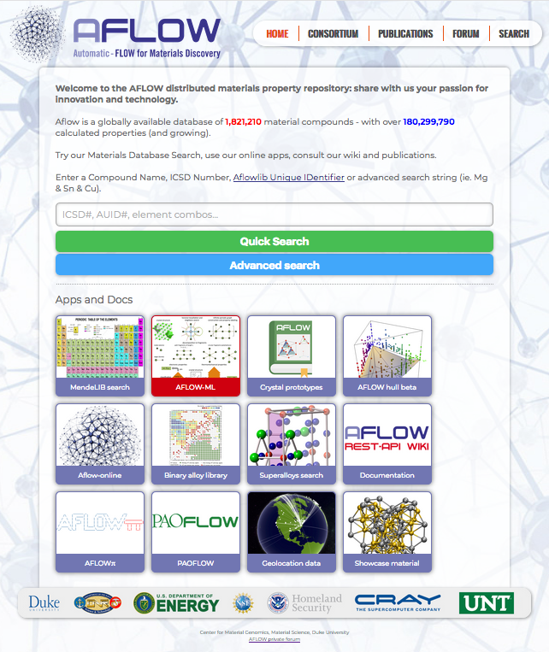
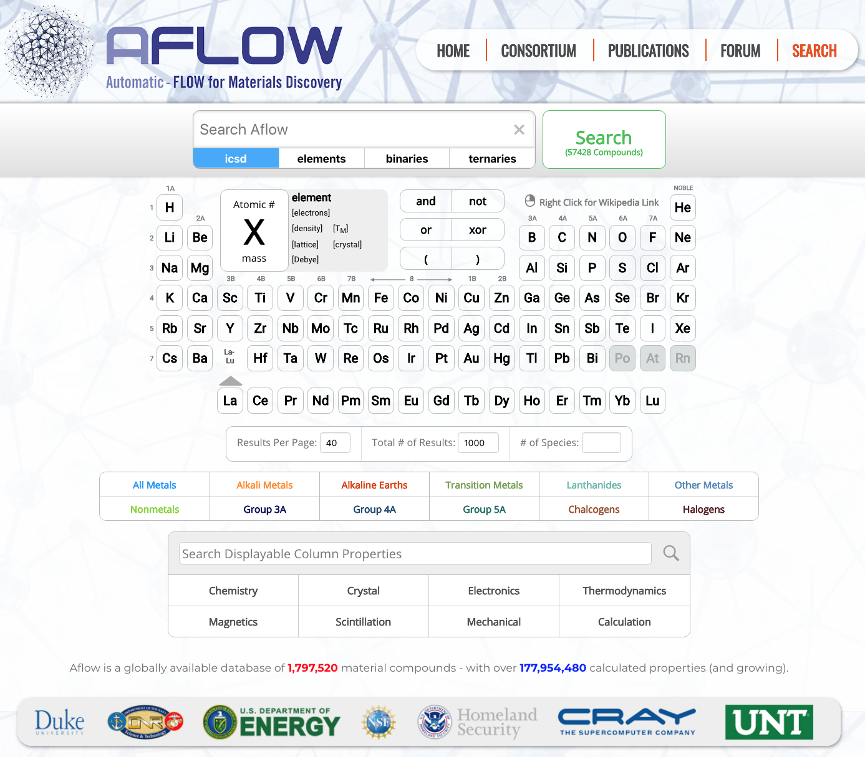



AFLOW: Integrated infrastructure for computational materials discovery
CORMAC TOHER
COREY OSES
DAVID HICKS
E. Gossett,
F. Rose,
S. Curtarolo
Materials Science
Duke University
E

Slide 2
Outline
Getting started with AFLOW:
Decorating crystal prototypes to set up new calculations
Symmetry analysis
Thermodynamic and thermo-mechanical
Convex hull phase diagrams
AEL/AGL/APL: Elastic constants and thermal properties
AFLOW online data repositories
AFLOW.org online web interface
AFLOW REST-API
AFLUX Search-API
AFLOW-ML + API
AFLOW code:
Installing AFLOW
Data analysis with AFLOW
Running AFLOW calculations

Slide 3
Outline
Getting started with AFLOW:
Decorating crystal prototypes to set up new calculations
Symmetry analysis
Thermodynamic and thermo-mechanical
Convex hull phase diagrams
AEL/AGL/APL: Elastic constants and thermal properties
AFLOW online data repositories
AFLOW.org online web interface
AFLOW REST-API
AFLUX Search-API
AFLOW-ML + API
AFLOW code:
Installing AFLOW
Data analysis with AFLOW
Running AFLOW calculations

Slide 4


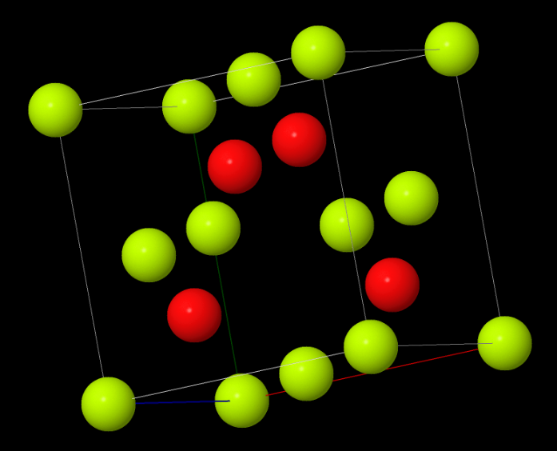
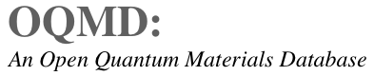
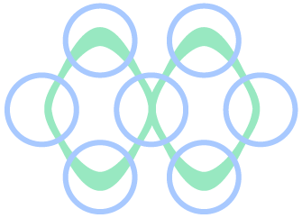

Automated Materials Discovery
Automated computational materials discovery:
Experimental structures
Automated QM calculations
Structural prototypes
Density functional theory
Searchable/sortable database
Candidate materials
ML models

Slide 5
AFLOW: Automatic FLOW
AFLOW
Input file generation
aflow.in
DFT-code
DFT-code
DFT-code
Calculation management
DFT-code
ERROR?
Property calculation
Electronic
Thermal
Elastic
AFLOW source code now available under GPL 3
materials.duke.edu/AFLOW/
Database storage
Storage
Curtarolo et al., Comput. Mater. Sci. 58, 218 (2012); Calderon et al., Comp. Mat. Sci. 108A, 233 (2015)

Slide 6
AFLOW.org: web portal
http://aflow.org
> 1.8 million entries
Advanced Search
Crystal Prototypes
Machine-learning model
Convex hull
AFLOW-online
(AFLOW-SYM)
Curtarolo et al., Comput. Mater. Sci. 58, 218 (2012); Curtarolo et al., Comput. Mater. Sci. 58, 227 (2012)

Slide 7
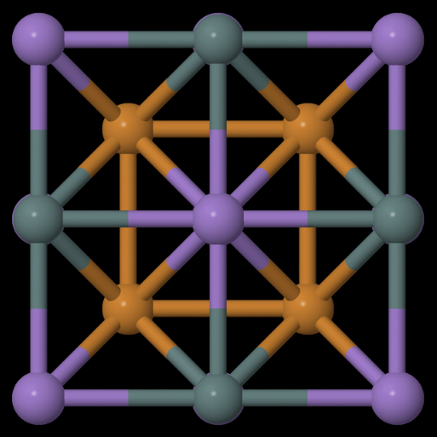
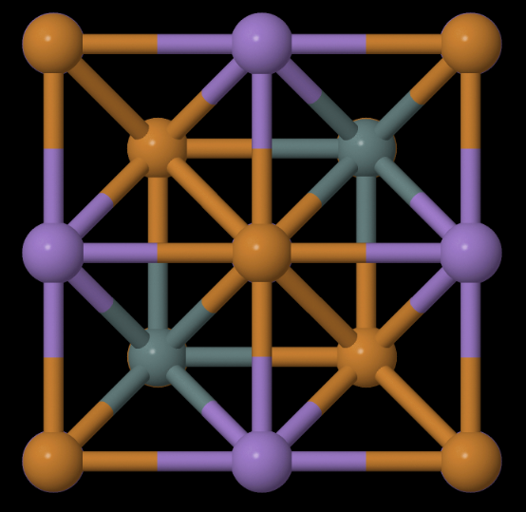
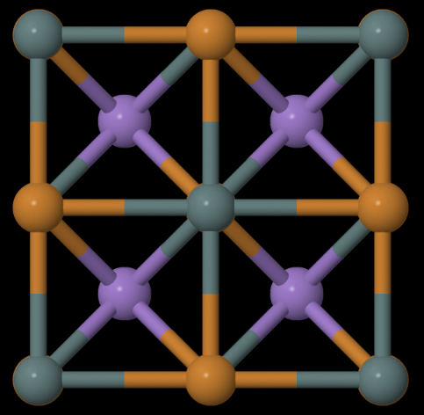
AFLOW: Crystallographic Prototypes
AFLOW contains built-in structural prototypes:
G (p, T; V) = E + pV
Prototype T0001: Heusler structure
Prototype T0002:
Anti-Heusler structure
Prototype T0003:
Half-Heusler structure
Decorating prototypes with different elements allows for automated creation of new hypothetical materials
~600 prototypes available at aflow.org/CrystalDatabase
M. J. Mehl et al., Comput. Mater. Sci. 136, S1-S828 (2017); D. Hicks et al., submitted (2018)

Slide 8
AFLOW: Crystallographic Prototypes
http://aflow.org
Crystal Prototypes
M. J. Mehl et al., Comput. Mater. Sci. 136, S1-S828 (2017); D. Hicks et al., submitted (2018)

Slide 9
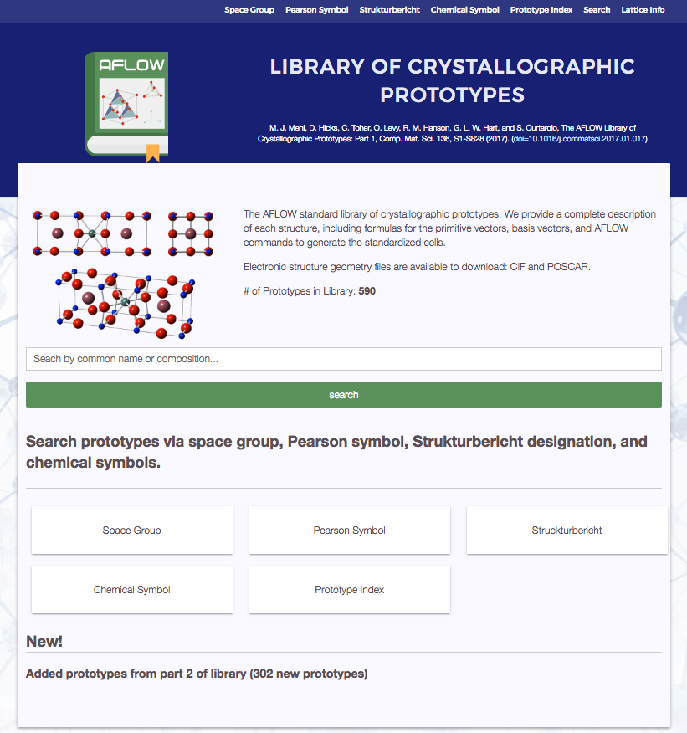
AFLOW: Crystallographic Prototypes
M. J. Mehl et al., Comput. Mater. Sci. 136, S1-S828 (2017); D. Hicks et al., submitted (2018)

Slide 10
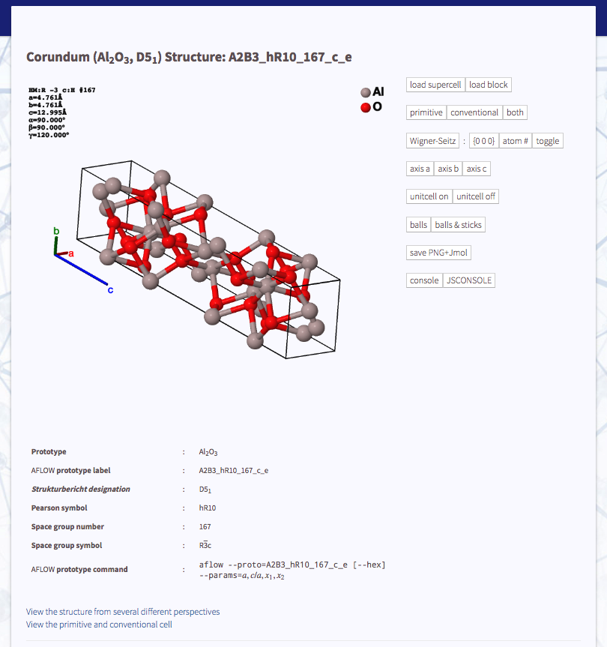
AFLOW: Crystallographic Prototypes
G (p, T; V) = E + pV
Jmol interface
Prototype information
M. J. Mehl et al., Comput. Mater. Sci. 136, S1-S828 (2017); D. Hicks et al., submitted (2018)

Slide 11
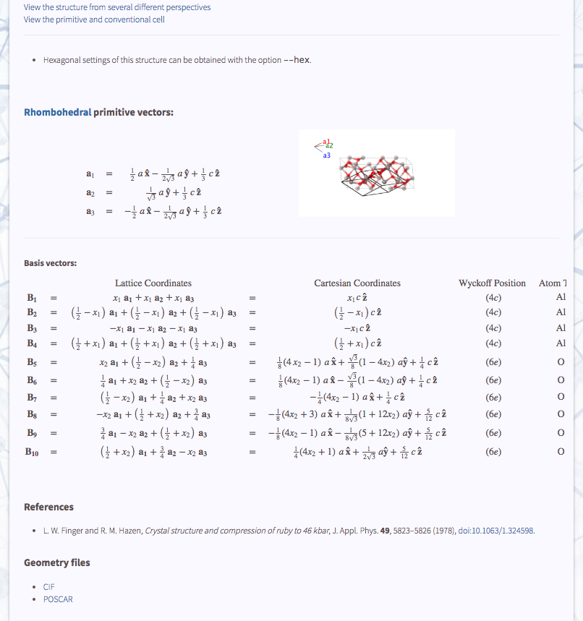
AFLOW: Crystallographic Prototypes
G (p, T; V) = E + pV
Primitive lattice vectors
Atomic basis vectors
References
Geometry files
M. J. Mehl et al., Comput. Mater. Sci. 136, S1-S828 (2017); D. Hicks et al., submitted (2018)

Slide 12
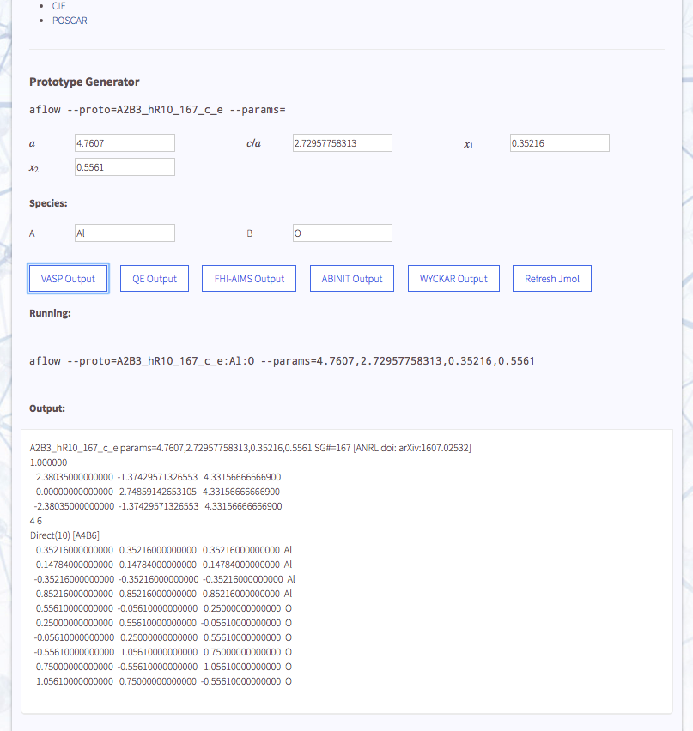
AFLOW: Crystallographic Prototypes
Prototype generator
G (p, T; V) = E + pV
Format options
AFLOW command
Structure output
M. J. Mehl et al., Comput. Mater. Sci. 136, S1-S828 (2017); D. Hicks et al., submitted (2018)

Slide 13
AFLOW: Crystallographic Prototypes
Exercises:
Select a prototype from the Library of Crystallographic Prototypes at aflow.org/ CrystalDatabase/. Use the online tool to create a POSCAR for that structure, decorated with elements of your choice.
Generate structures for the prototype A_hR1_166_a using an element and value of a of your choice, with c/a values of 0.5, 0.612, 1.0, 1.225, 1.5, 2.45, and 3.0. Save these structures with appropriate names, as they will be used as part of a later exercise.
G (p, T; V) = E + pV
M. J. Mehl et al., Comput. Mater. Sci. 136, S1-S828 (2017); D. Hicks et al., submitted (2018)

Slide 14
AFLOW-SYM
AFLOW-SYM tests invariance of crystal under transformations
G (p, T; V) = E + pV
Provides information on space group, Pearson symbol, Bravais lattice, primitive and conventional cell, etc.
API keywords: spacegroup_relax, Pearson_symbol_relax, Bravais_lattice_orig, …
D. Hicks et al., Acta Cryst. A74, 184-203 (2018)

Slide 15
AFLOW-SYM
G (p, T; V) = E + pV
Mismatch with respect to space group listed in description of experimental structure in ICSD
D. Hicks et al., Acta Cryst. A74, 184-203 (2018)

Slide 16
AFLOW-SYM
G (p, T; V) = E + pV
AFLOW-SYM performs self-consistent tolerance scan when transformations are inconsistent with ITC space groups, or when inconsistencies exist between different representations.
D. Hicks et al., Acta Cryst. A74, 184-203 (2018)

Slide 17
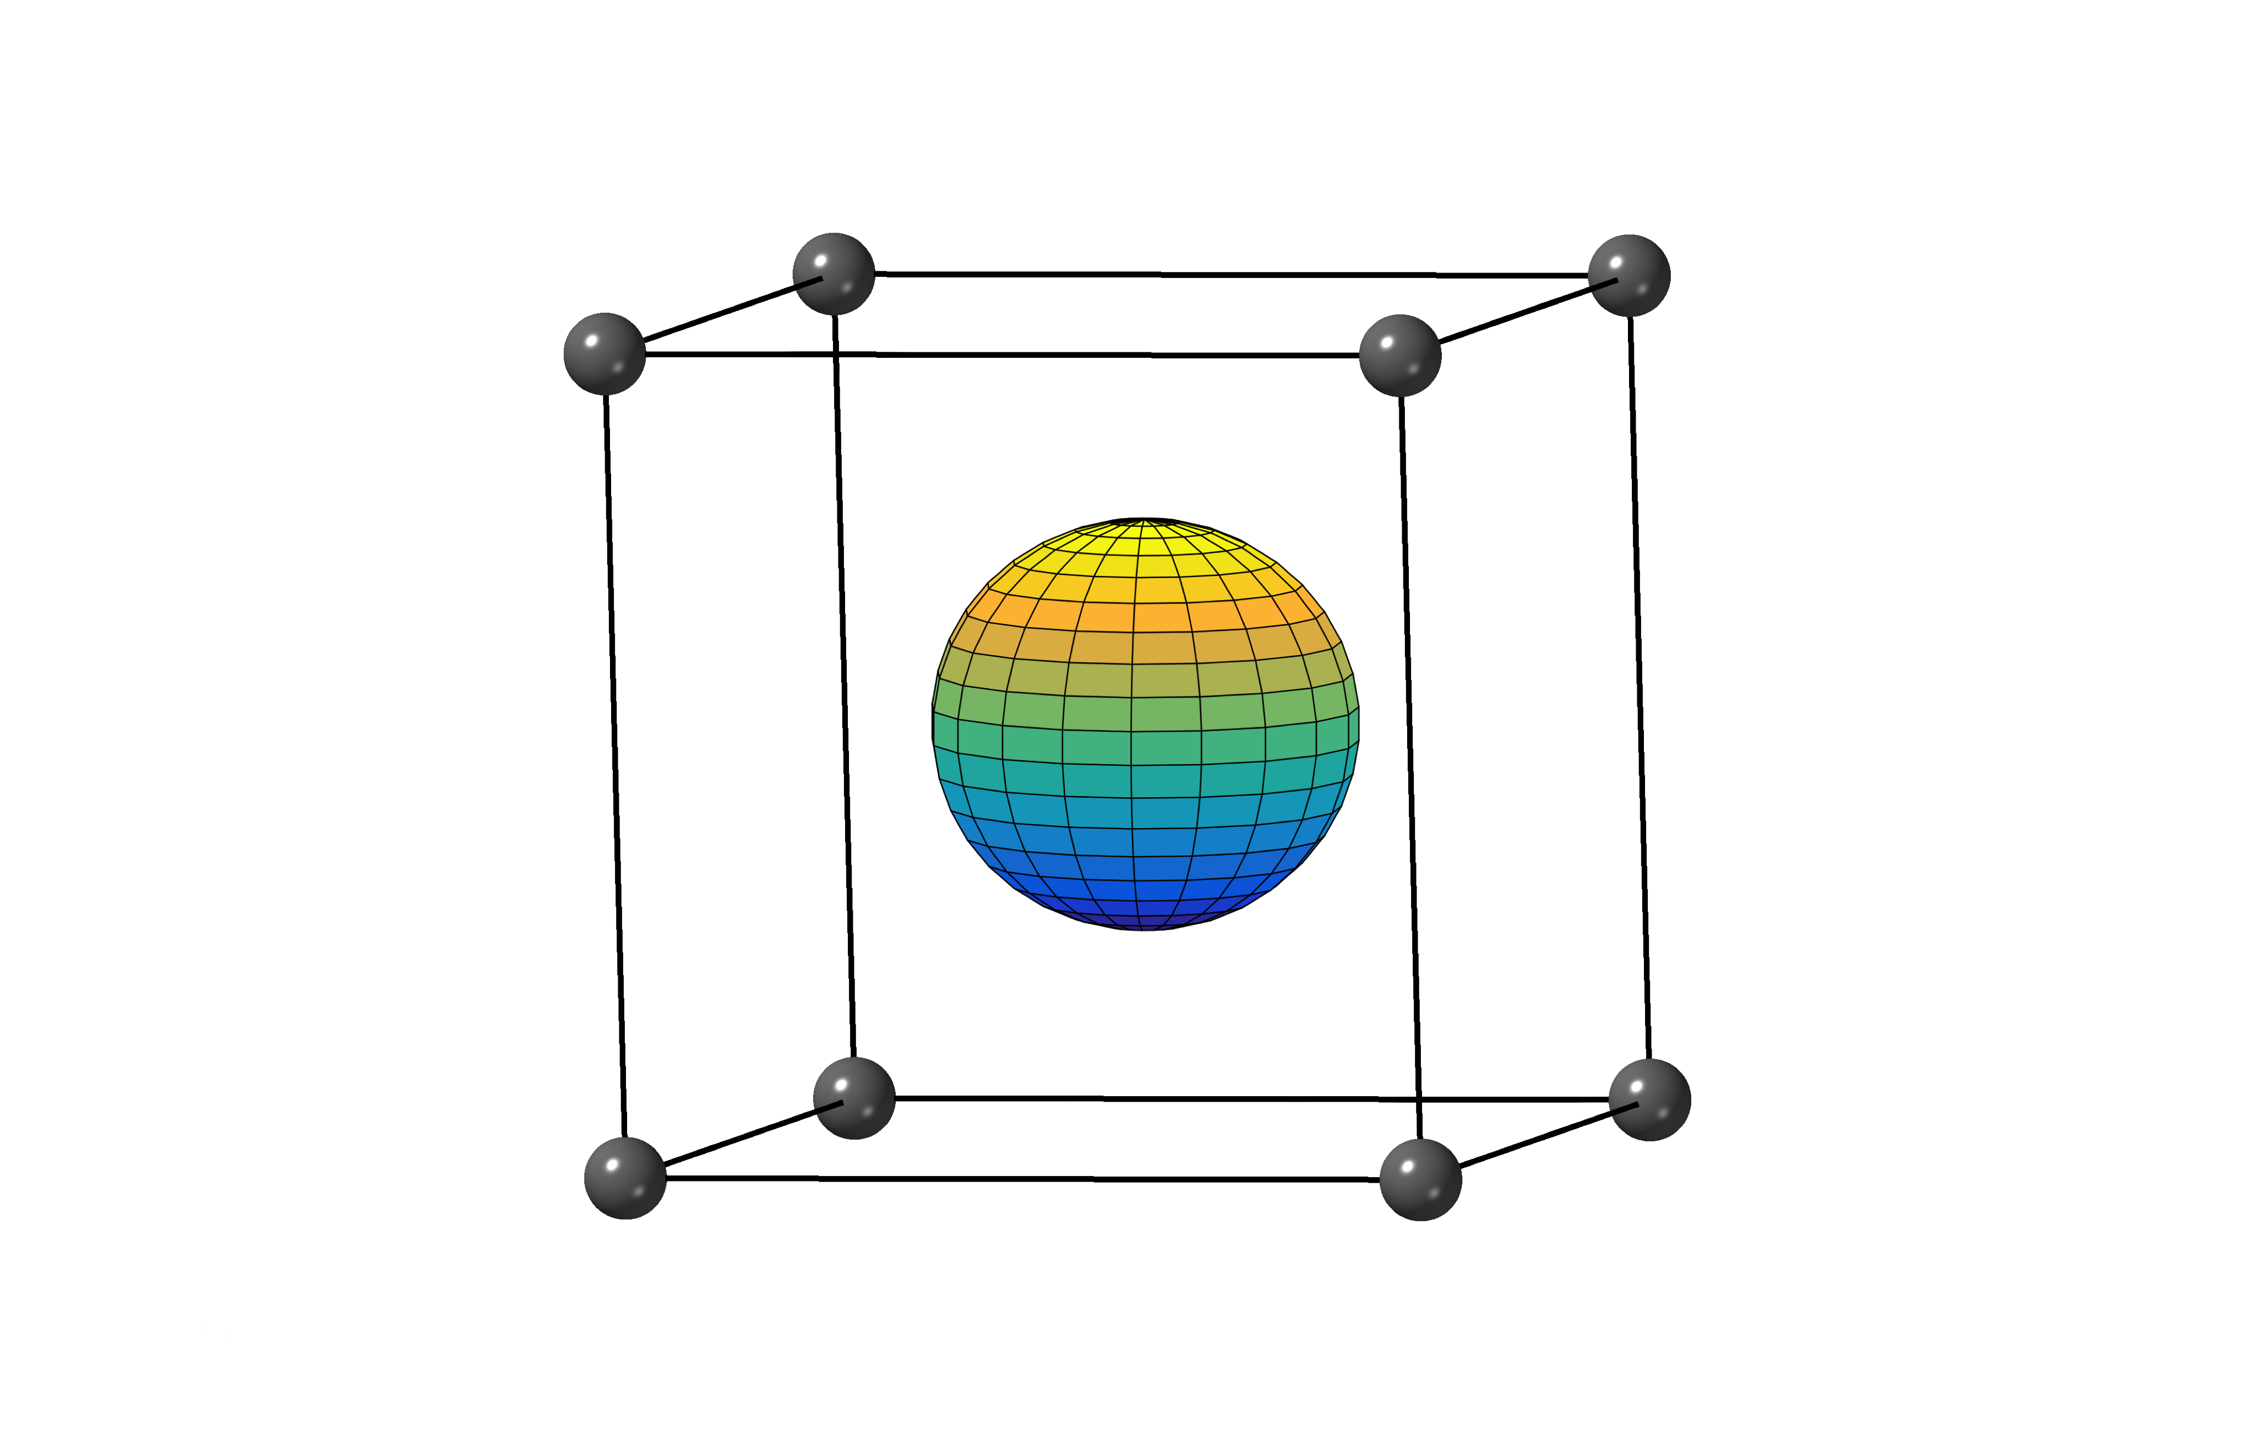
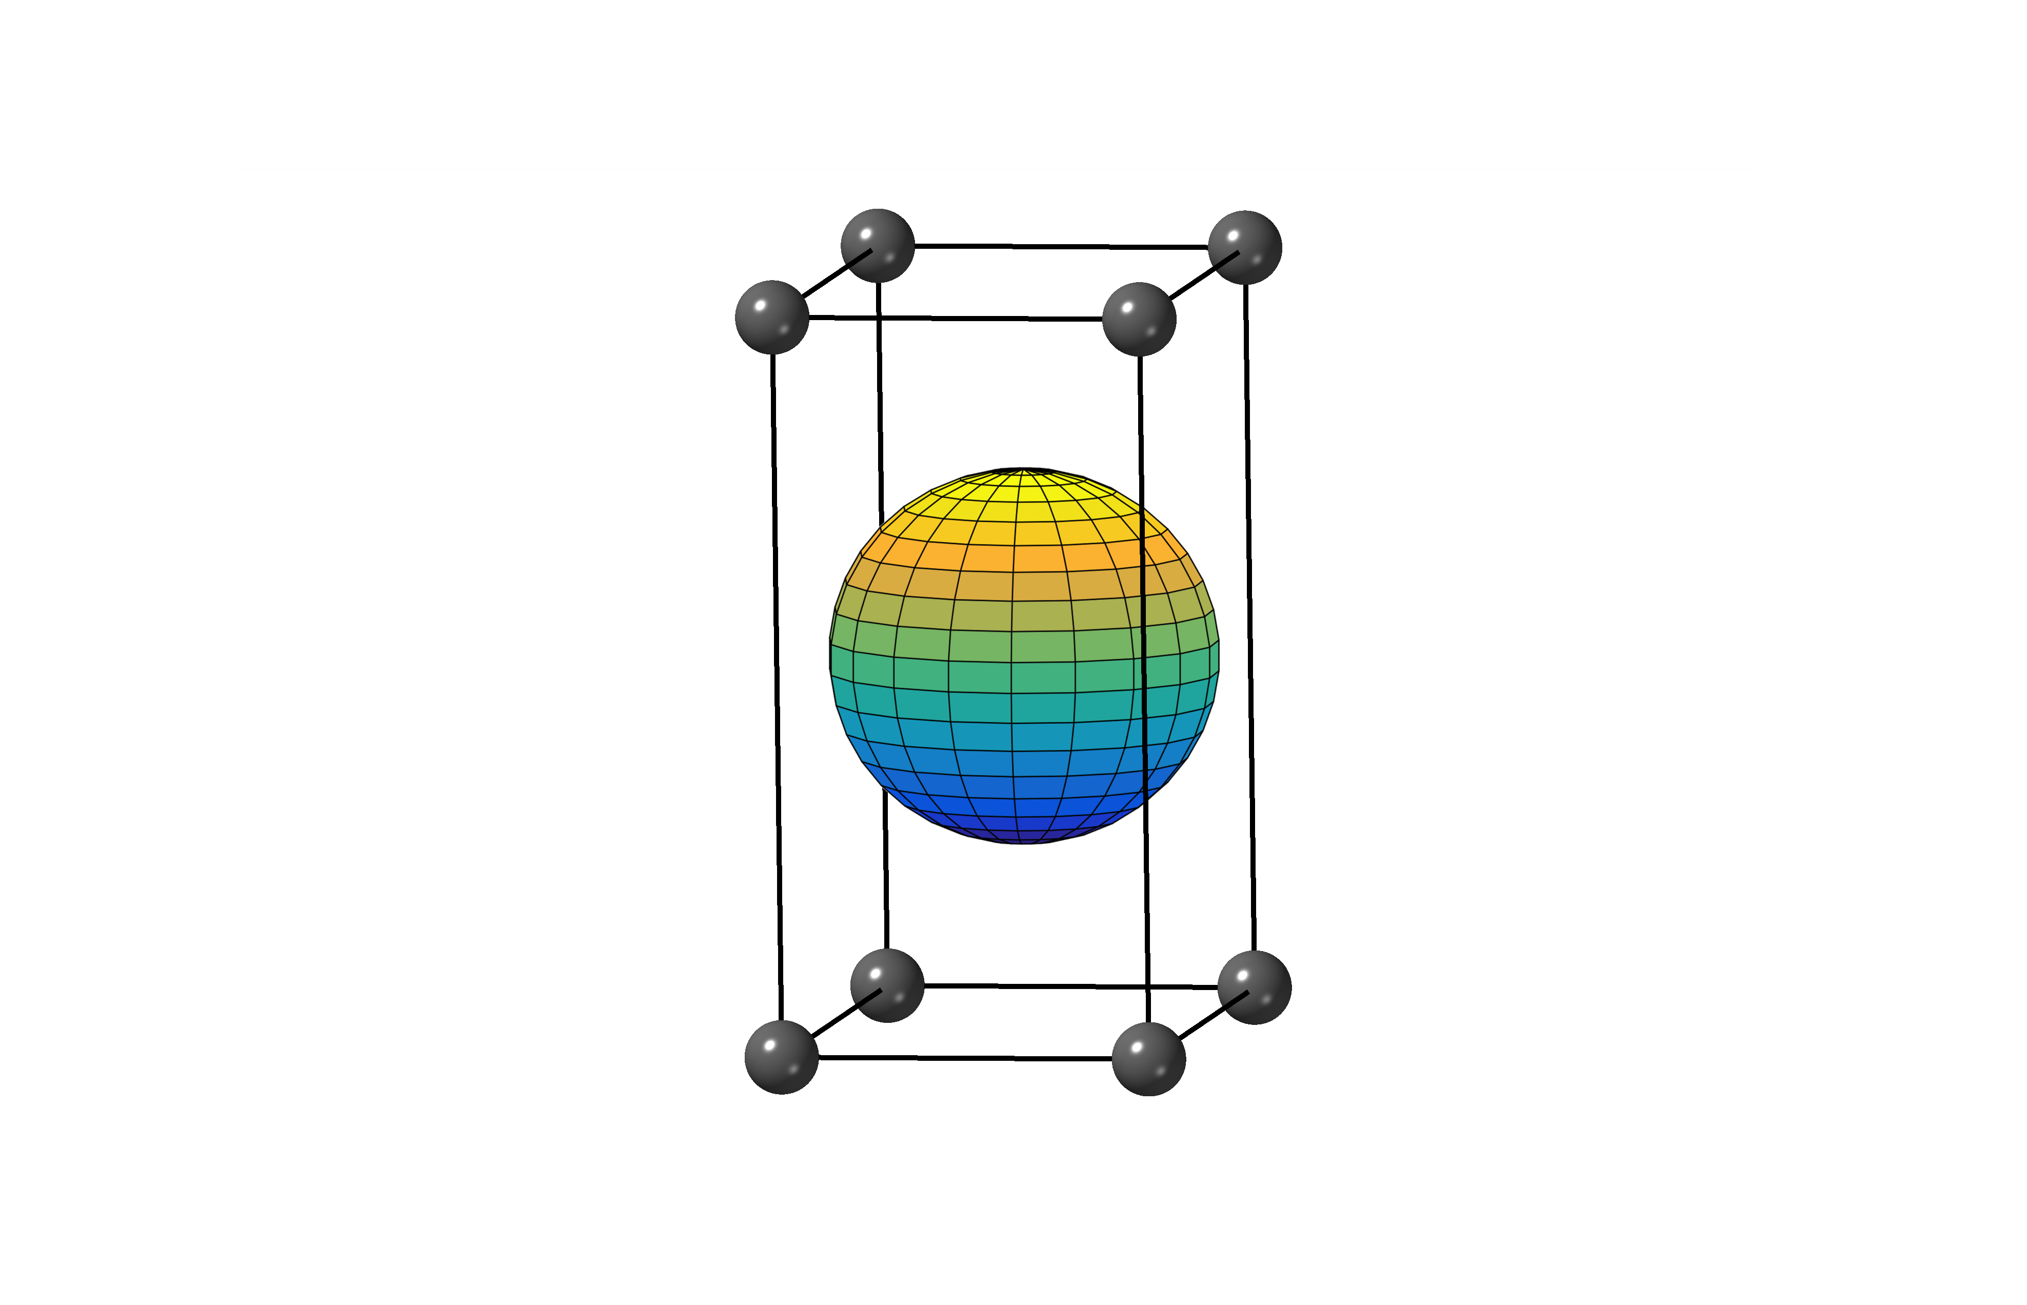
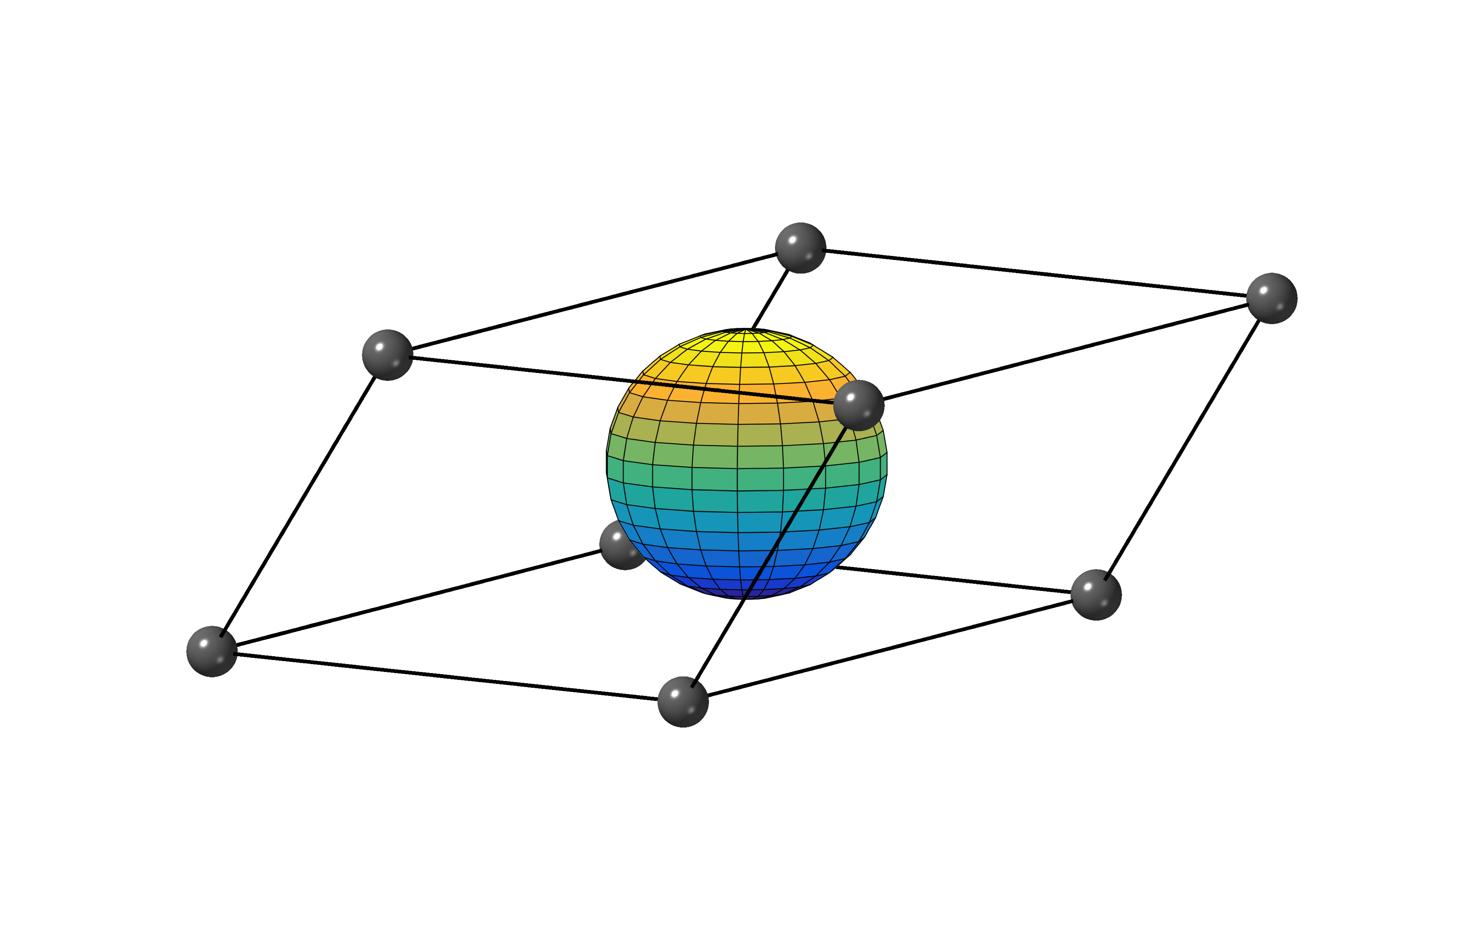
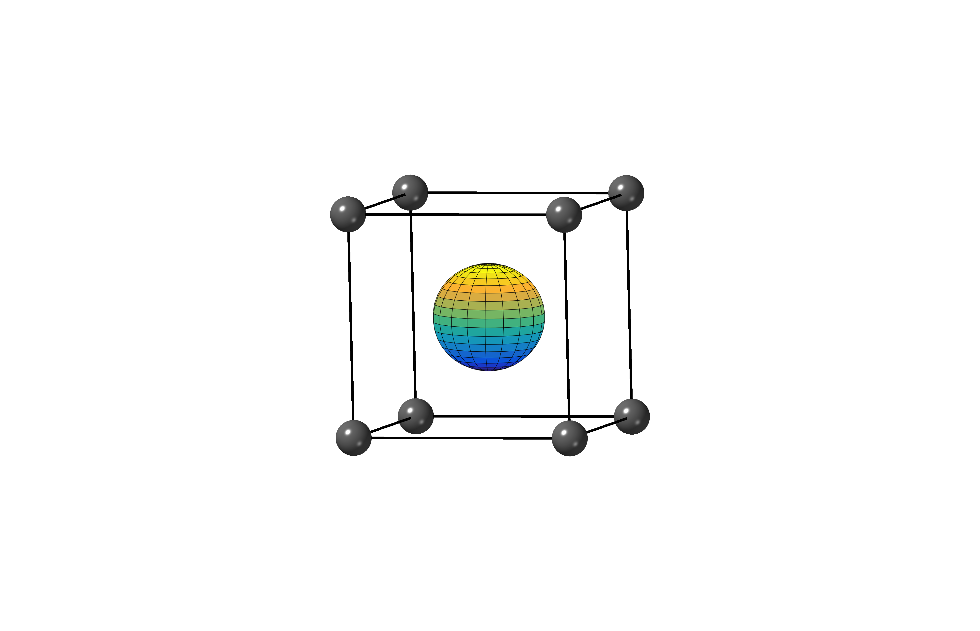
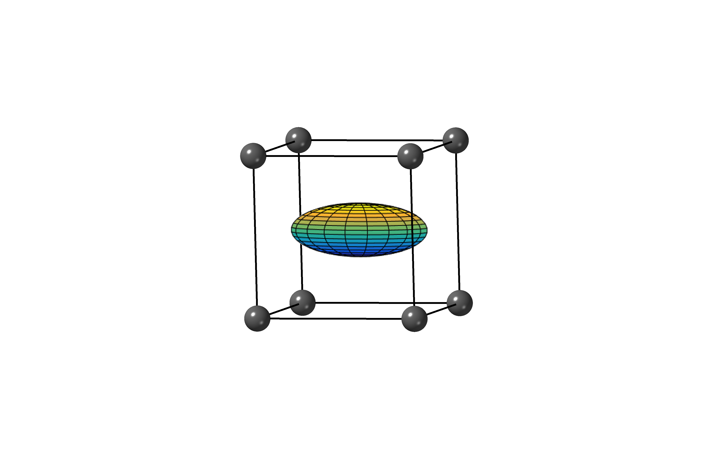
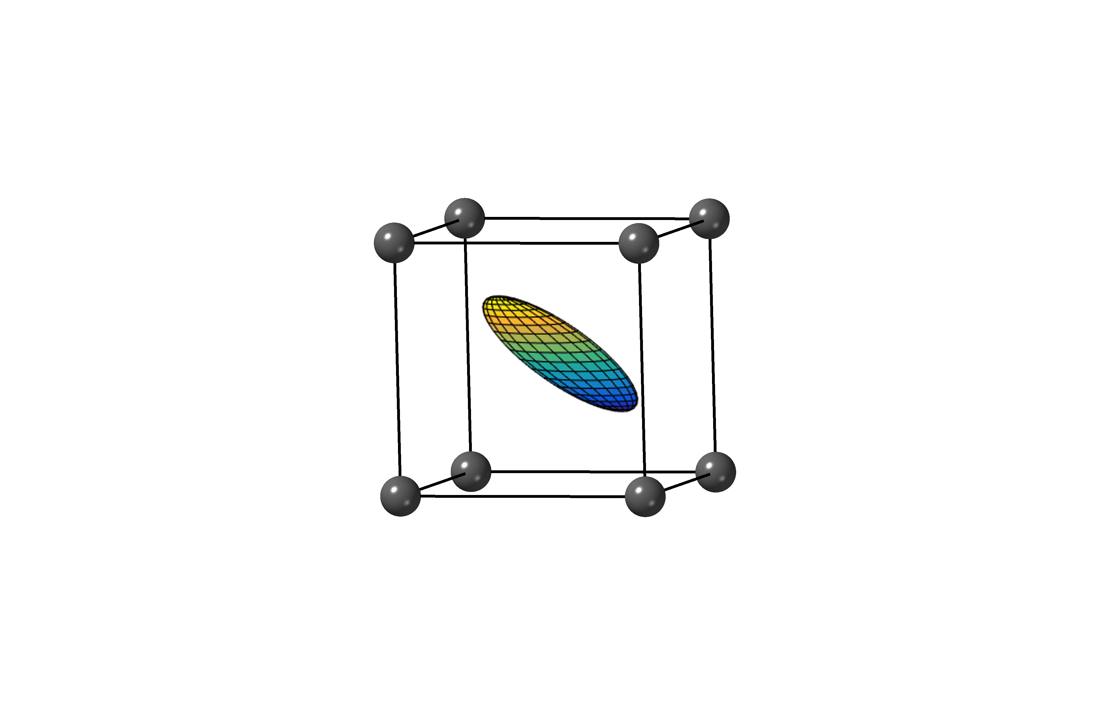
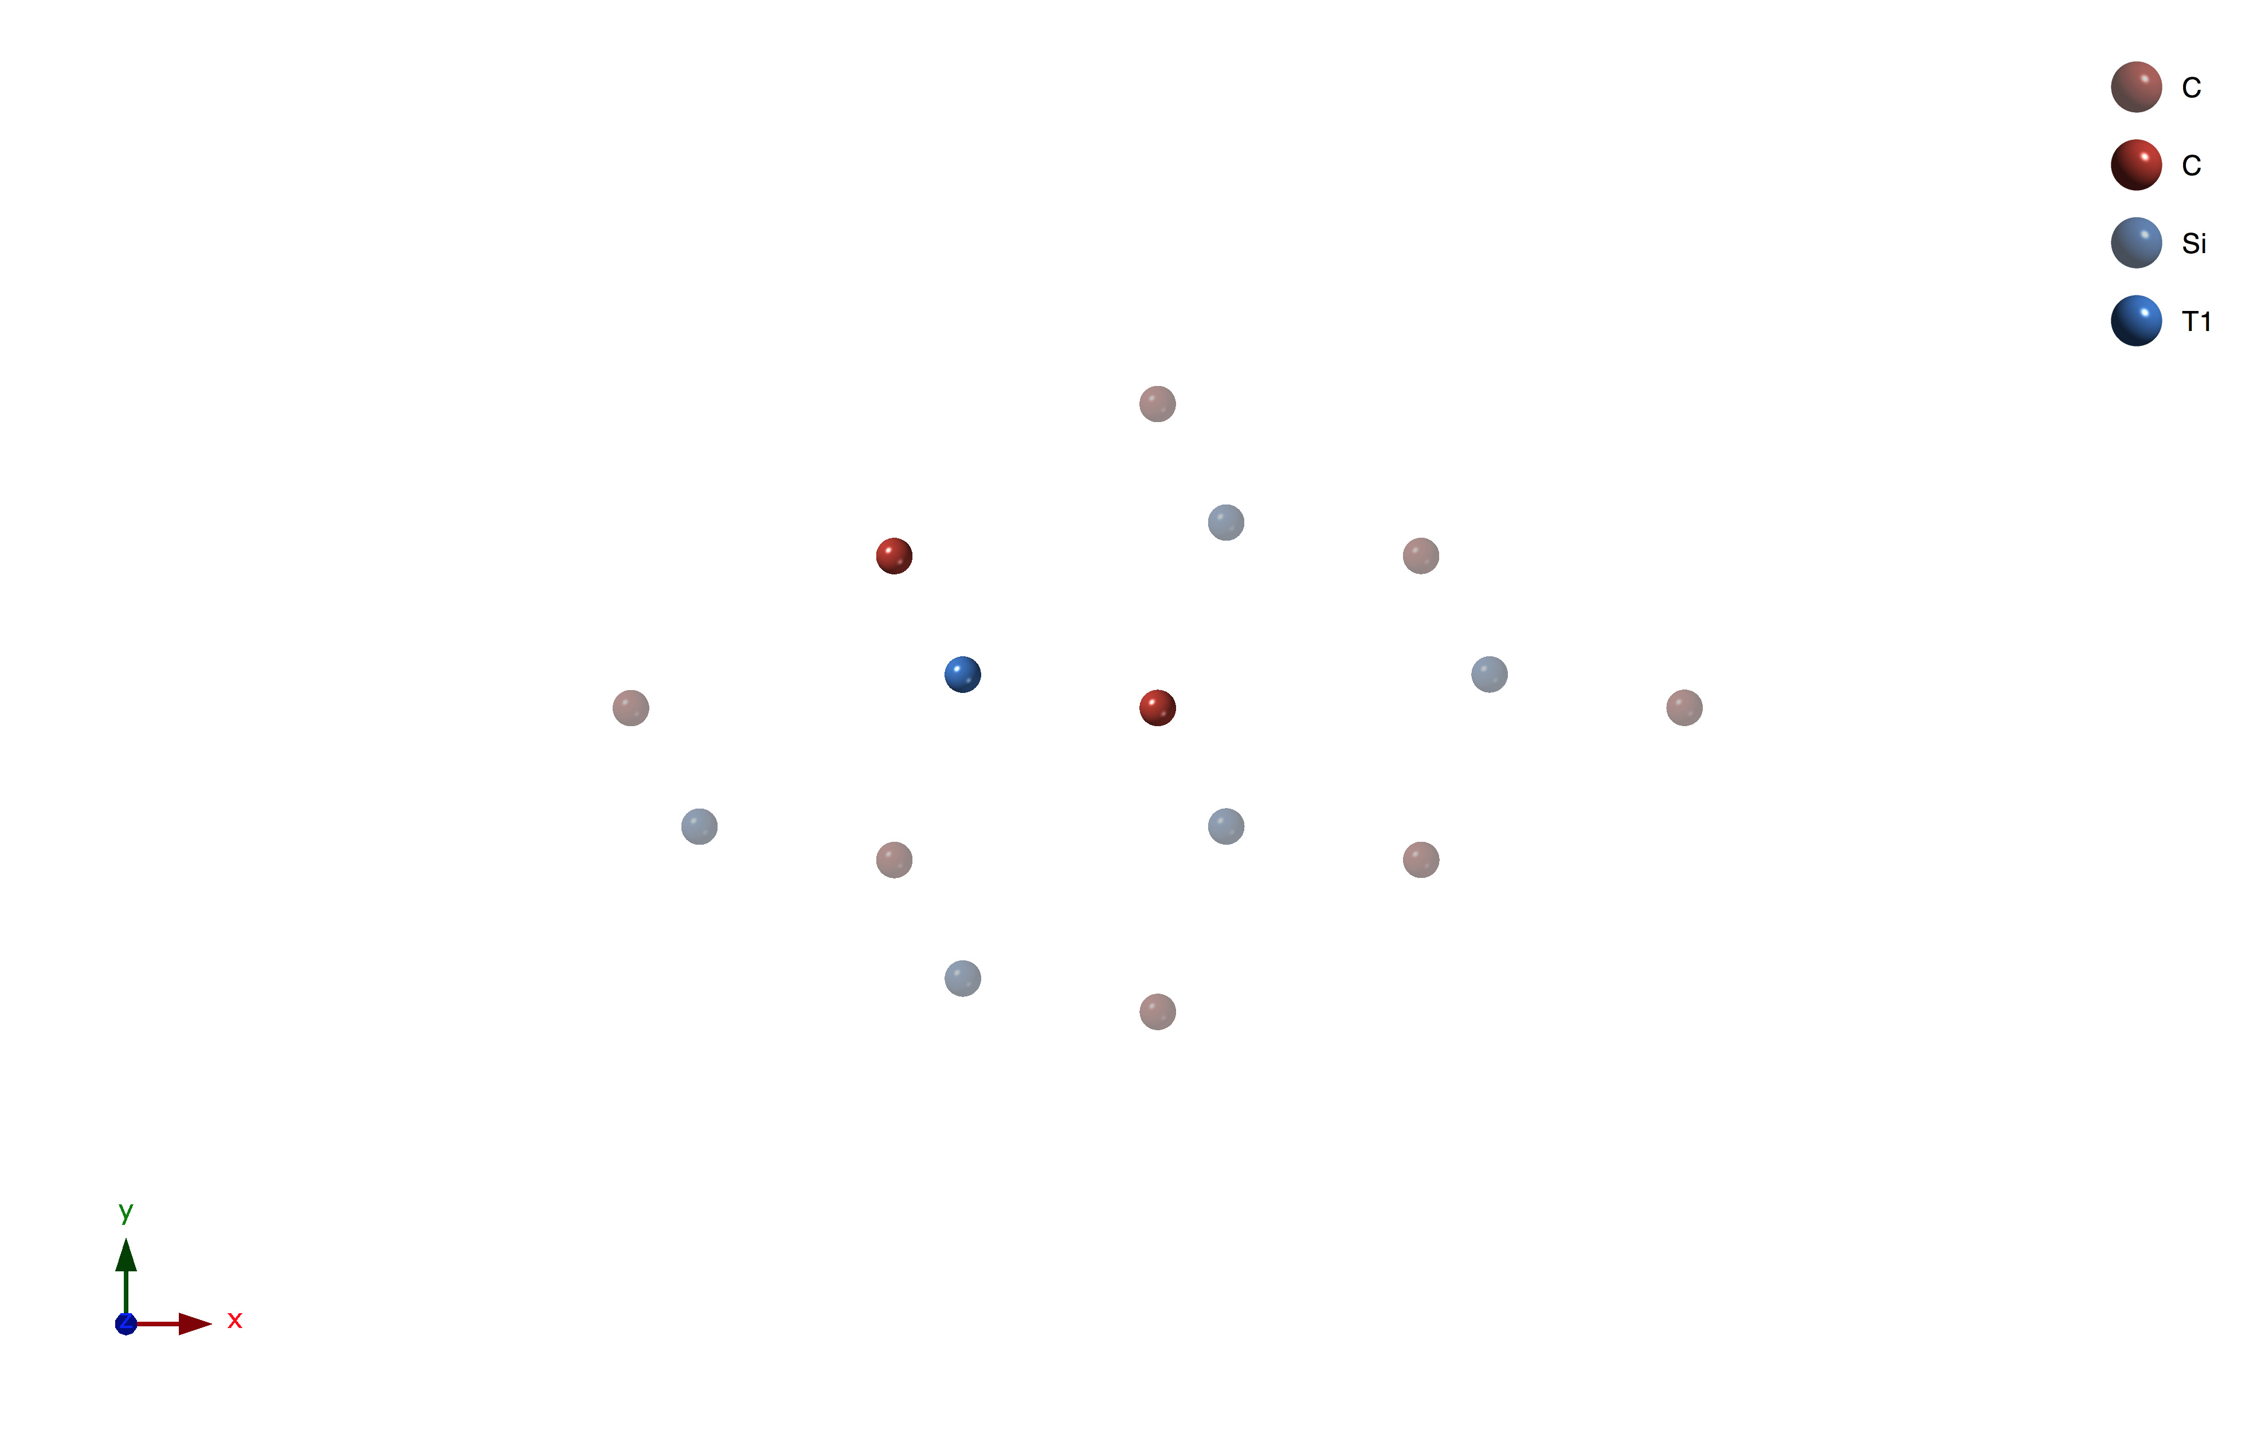
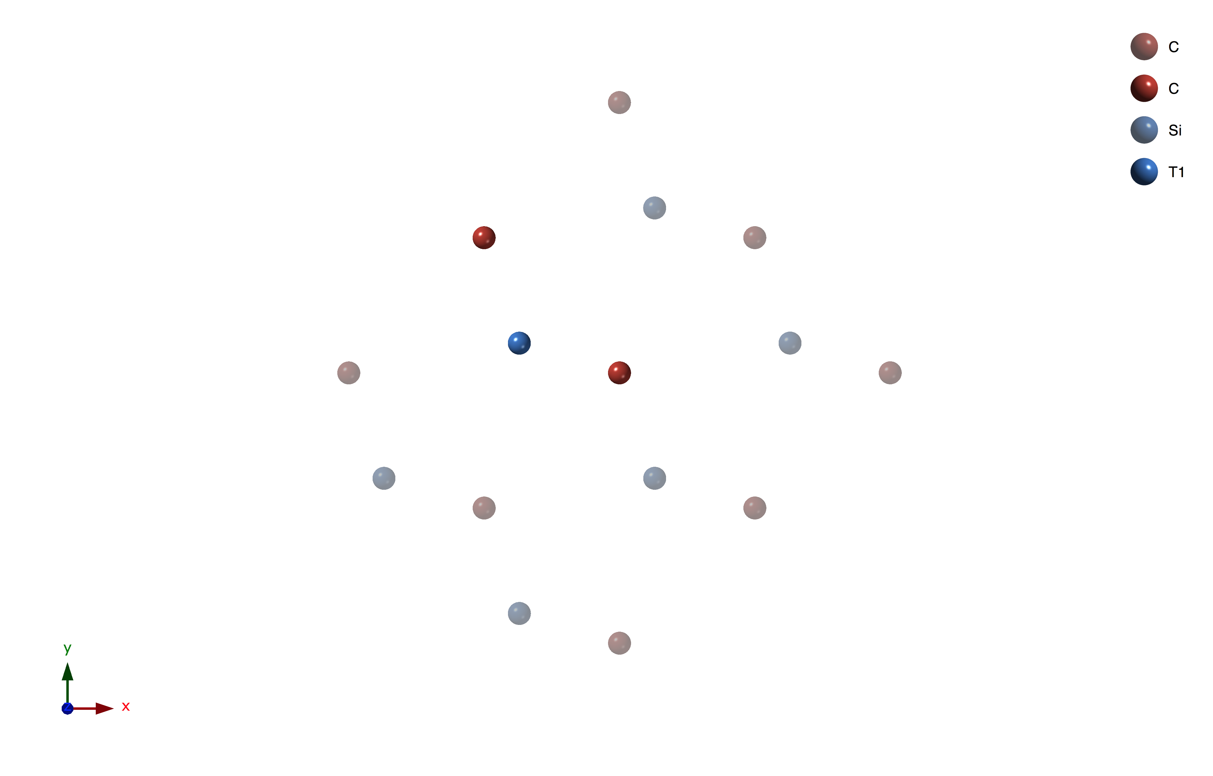
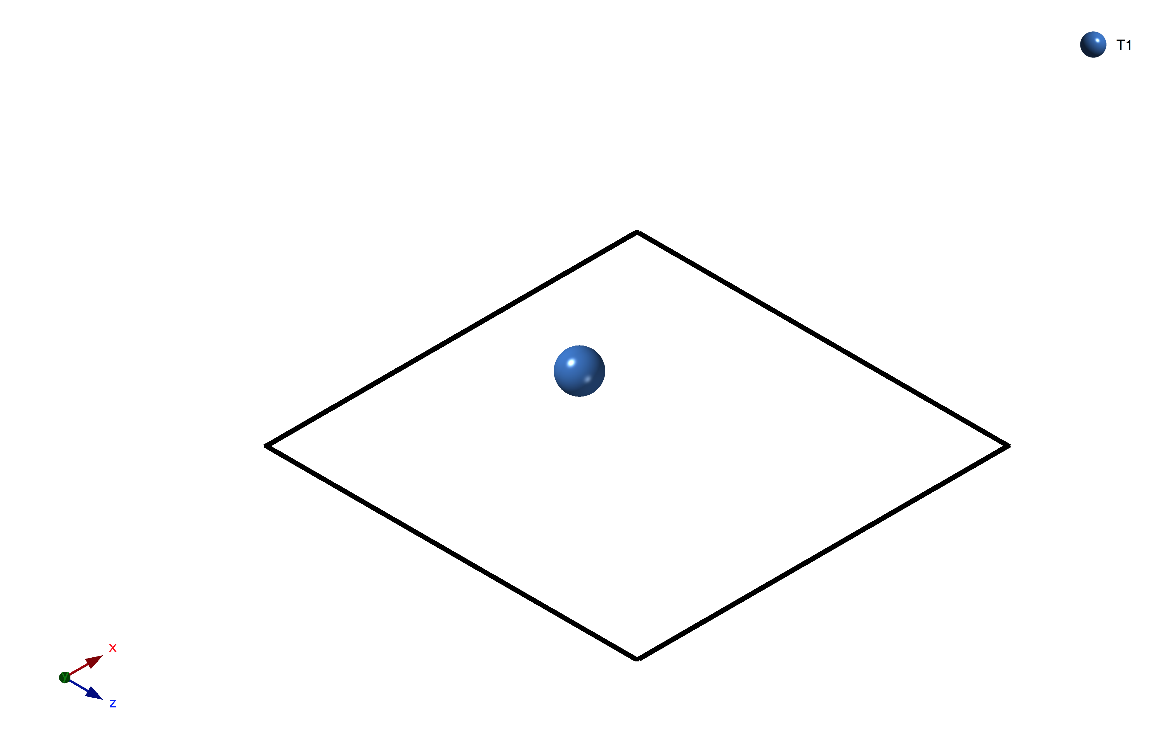
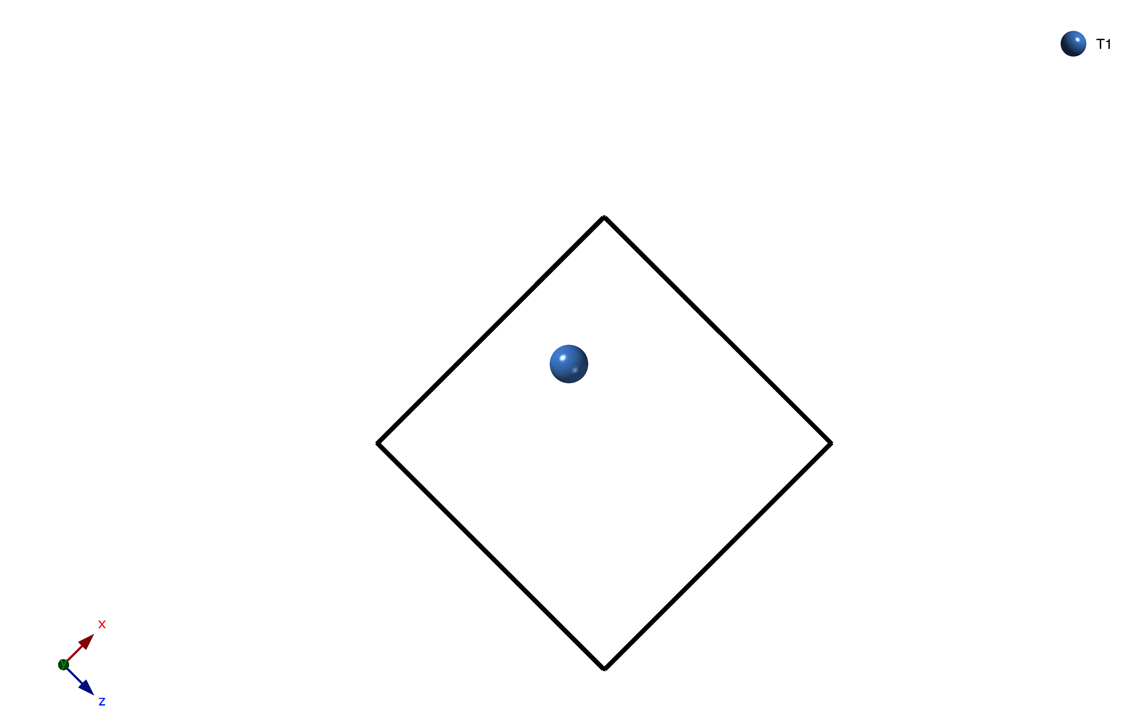
AFLOW-SYM
cubic
orthorhombic
triclinic
Cartesian
fractional
Cartesian
fractional
minimum in fractional ≠ minimum in Cartesian
AFLOW-SYM consists of robust mapping procedure; takes lattice skewness into account
D. Hicks et al., Acta Cryst. A74, 184-203 (2018)

Slide 18
AFLOW-SYM: AFLOW-Online
http://aflow.org
AFLOW-online
(AFLOW-SYM)
D. Hicks et al., Acta Cryst. A74, 184-203 (2018)

Slide 19
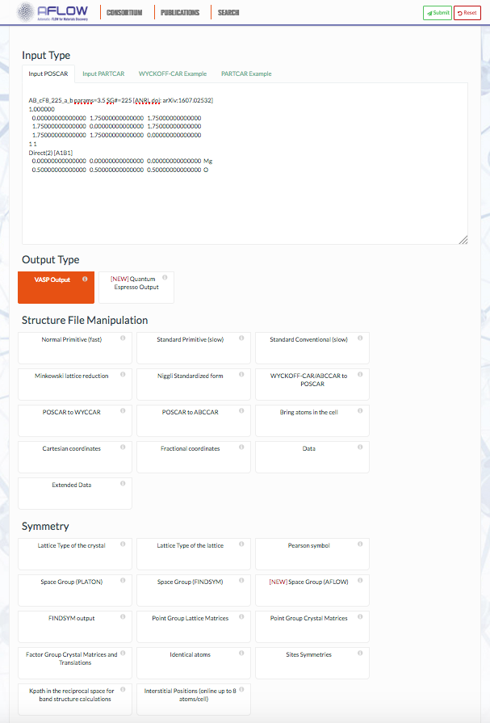
AFLOW-SYM: AFLOW-Online
Submit here when ready
Enter POSCAR here
Select AFLOW-SYM here
D. Hicks et al., Acta Cryst. A74, 184-203 (2018)

Slide 20
AFLOW-SYM
Exercises:
Use AFLOW-SYM to determine the symmetry properties of the structure that you generated using prototype you selected from the Library of Crystallographic Prototypes at aflow.org/CrystalDatabase/. What are the space group number and Pearson symbol for this material?
Use AFLOW-SYM to determine the symmetry properties of the structures that you generated for the prototype A_hR1_166_a. How do the choice of parameters affect the symmetry of the structure?
G (p, T; V) = E + pV
D. Hicks et al., Acta Cryst. A74, 184-203 (2018)

Slide 21
Outline
Getting started with AFLOW:
Decorating crystal prototypes to set up new calculations
Symmetry analysis
Thermodynamic and thermo-mechanical
Convex hull phase diagrams
AEL/AGL/APL: Elastic constants and thermal properties
AFLOW online data repositories
AFLOW.org online web interface
AFLOW REST-API
AFLUX Search-API
AFLOW-ML + API
AFLOW code:
Installing AFLOW
Data analysis with AFLOW
Running AFLOW calculations

Slide 22
AFLOW-CHULL: Convex Hull Phase Diagram
Convex hull phase diagram: formation enthalpy vs. concentration
G (p, T; V) = E + pV
\Delta H (A_{N_{\mathrm A}} B_{N_{\mathrm B}}) = H (A_{N_{\mathrm A}} B_{N_{\mathrm B}}) - (N_{\mathrm A}H(A) + N_{\mathrm B} H(B))
\Delta H (A_{x_{\mathrm A}} B_{x_{\mathrm B}}) = H (A_{x_{\mathrm A}} B_{x_{\mathrm B}}) - (x_{\mathrm A}H(A) + x_{\mathrm B} H(B))
API keywords: enthalpy_formation_atom, energy_cell, …
C. Oses et al., submitted arXiv:1806.06901 (2018)

Slide 23
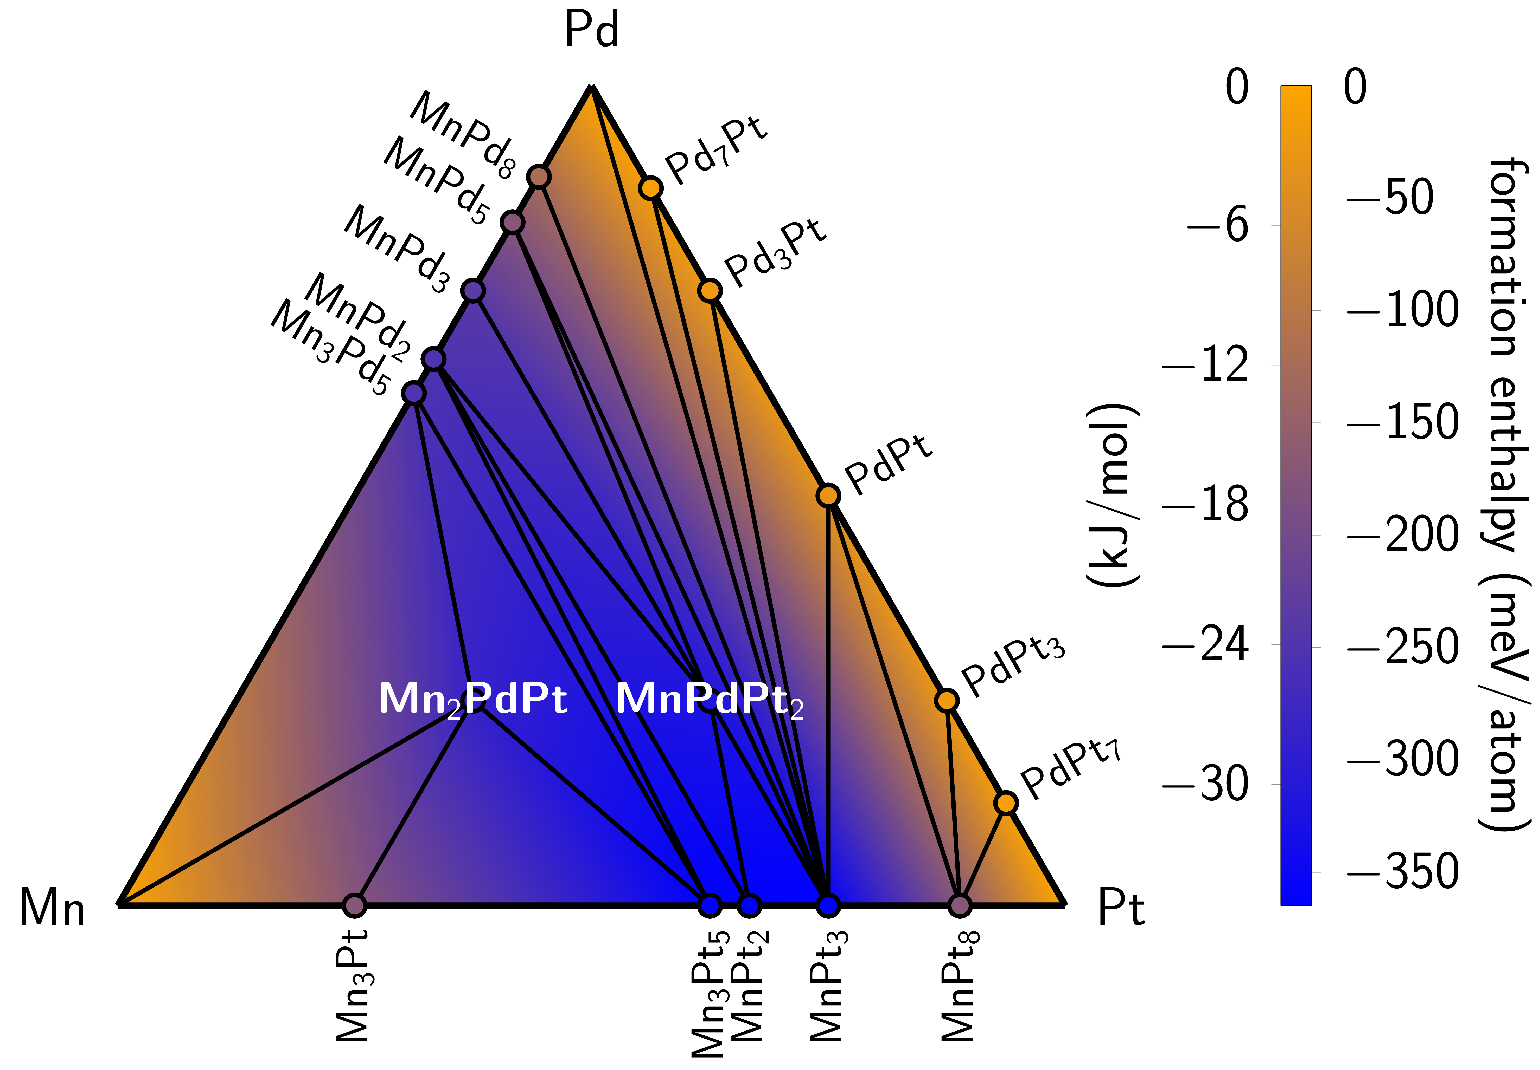
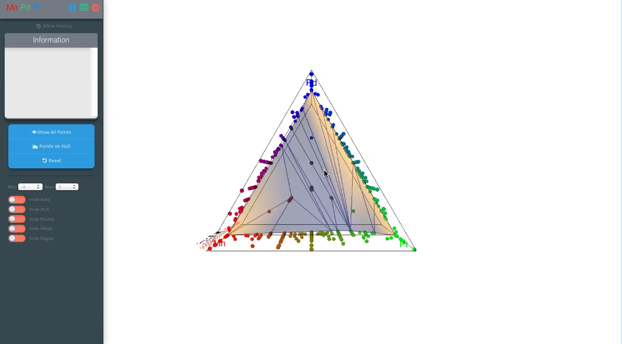
AFLOW-CHULL: Convex Hull Phase Diagram
Ternary convex hull phase diagrams:
Interactive online application: aflow.org/aflow-chull
C. Oses et al., submitted arXiv:1806.06901 (2018)

Slide 24
AFLOW-CHULL: Data curation
outlier detection and removal
Te3Zr1_ICSD_42076
Te3Zr1_ICSD_653211
Te3Zr1_ICSD_653232
Te3Zr1_ICSD_51004
Te3Zr1_ICSD_71033
Te3Zr1_ICSD_86763
Te3Zr1_ICSD_86764
structure match
C. Oses et al., submitted arXiv:1806.06901 (2018)

Slide 25
AFLOW-CHULL: Thermodynamic analyses
decomposition reaction
stability criterion
\mathrm{Pd}_{2}\mathrm{Pt}_{3} \to 1.5 ~ \mathrm{PdPt} + 0.5 ~ \mathrm{PdPt}_{3}
\Delta H_{\mathrm{f}} = 3~\mathrm{meV/atom}
\delta_{\mathrm{sc}}=6~\mathrm{meV/atom}
C. Oses et al., submitted arXiv:1806.06901 (2018)

Slide 26
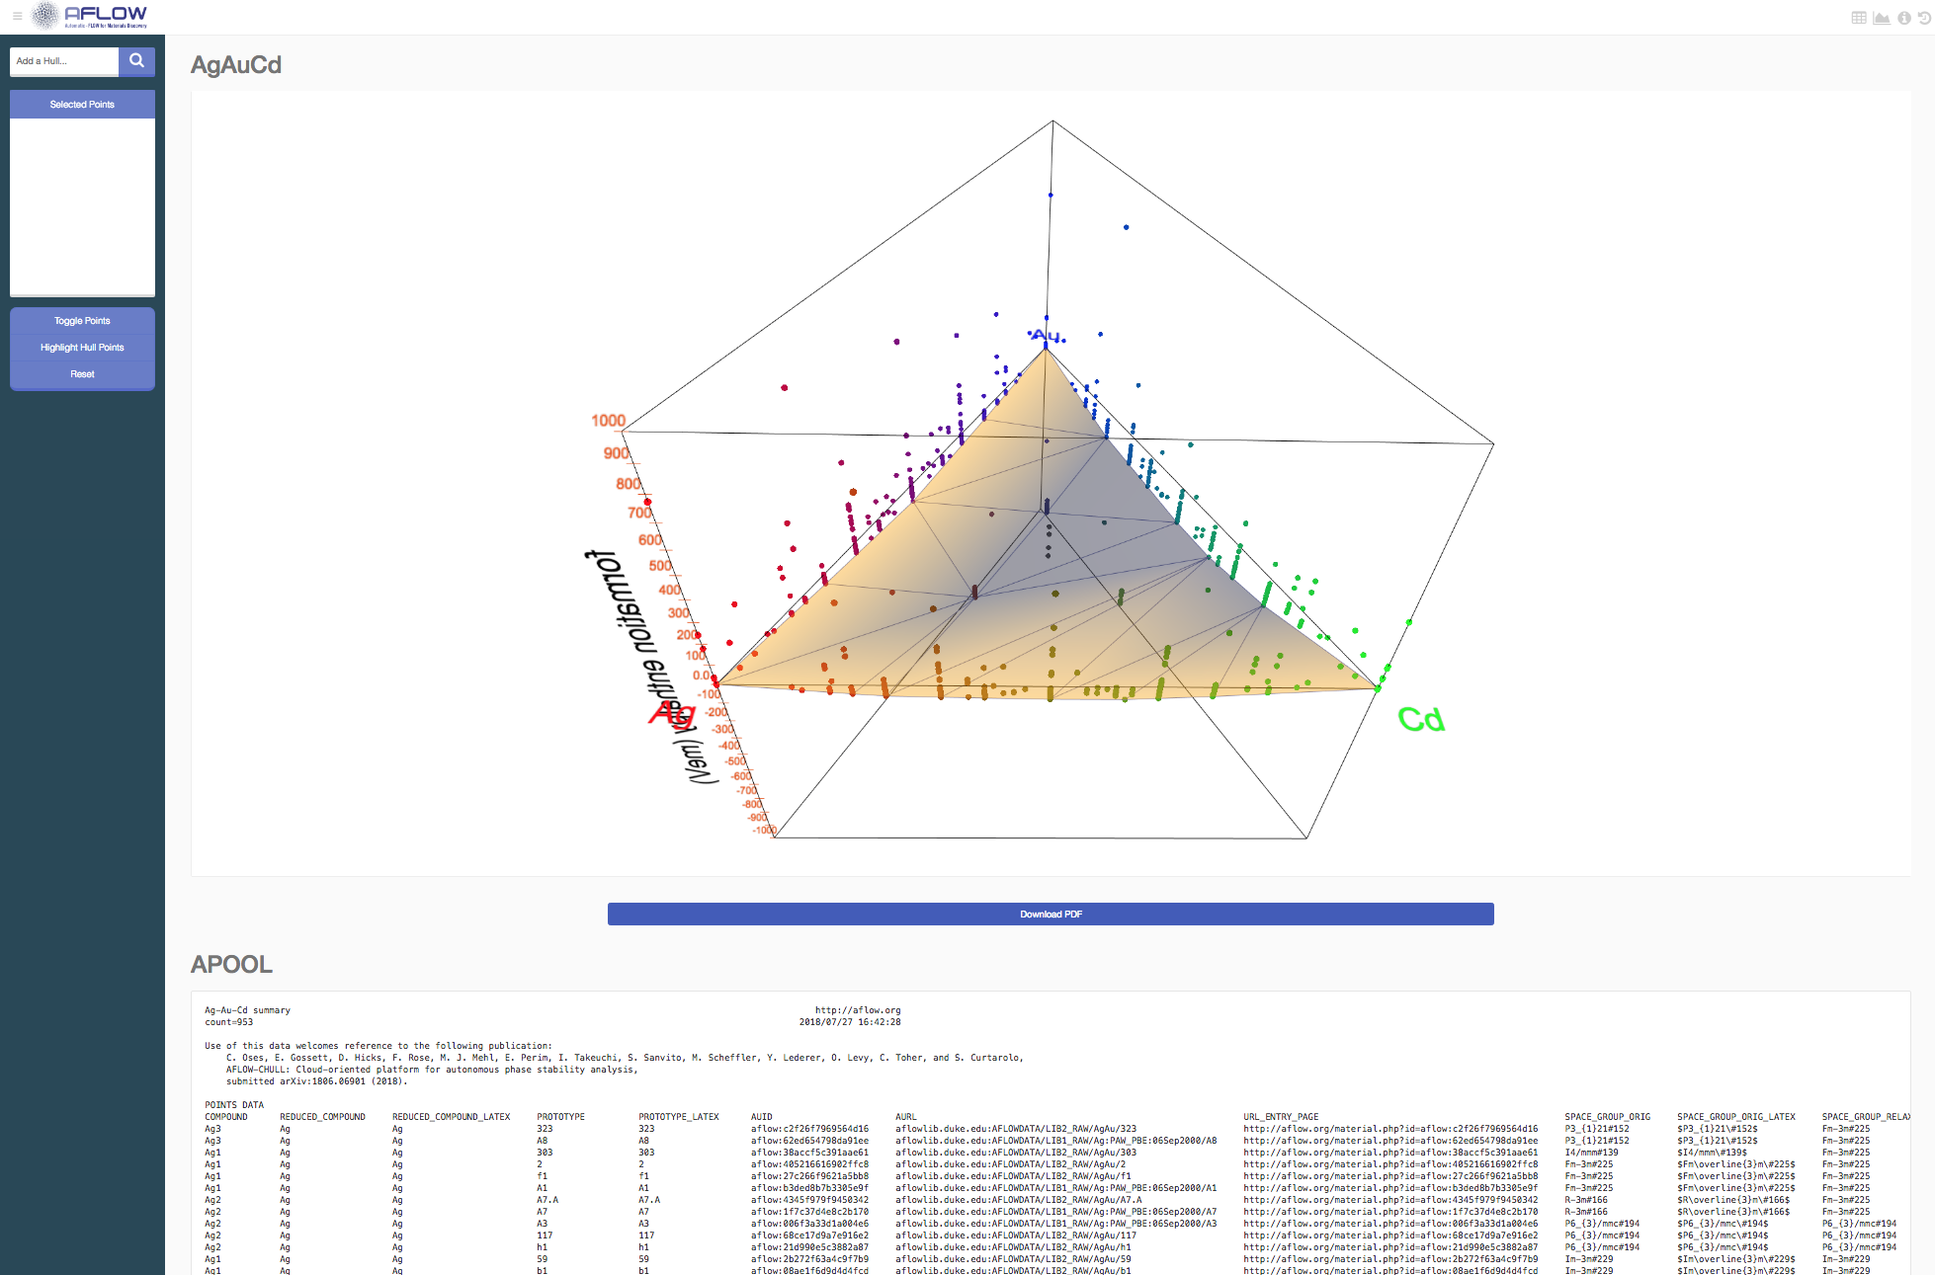
AFLOW-CHULL: Convex Hull Phase Diagram
aflow --chull --alloy=AgAuCd
Go to aflow.org/aflow-chull and type/select AgAuCd
G (p, T; V) = E + pV
C. Oses et al., submitted arXiv:1806.06901 (2018)

Slide 27
AFLOW-CHULL: Convex Hull Phase Diagram
aflow --chull --alloy=AgAuCd
Click “Download PDF”
G (p, T; V) = E + pV
C. Oses et al., submitted arXiv:1806.06901 (2018)

Slide 28
AFLOW-CHULL: Convex Hull Phase Diagram
aflow --chull --alloy=AgAuCd
Click “Highlight Hull Points” and click on one
G (p, T; V) = E + pV
C. Oses et al., submitted arXiv:1806.06901 (2018)

Slide 29
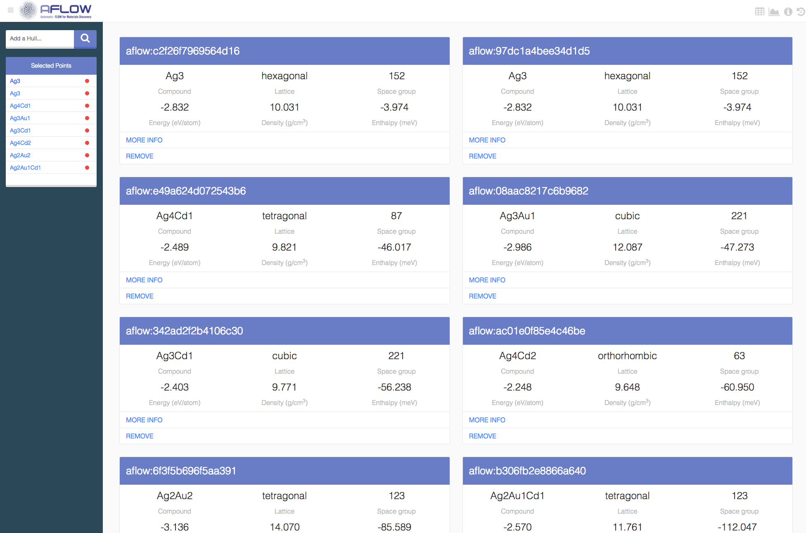
AFLOW-CHULL: Convex Hull Phase Diagram
aflow --chull --alloy=AgAuCd
Click “Highlight Hull Points” and click on one
G (p, T; V) = E + pV
C. Oses et al., submitted arXiv:1806.06901 (2018)

Slide 30
AFLOW-CHULL: Convex Hull Phase Diagram
Exercises:
What is the distance of Al₁₇Co₁₂ from the hull?
What is the stability criterion of Te₂Zr?
What is the energy of the CuZr hull at x = 0.5?
What is the most stable structure on the MnPdPt hull?
G (p, T; V) = E + pV
C. Oses et al., submitted arXiv:1806.06901 (2018)

Slide 31
AEL: Elastic constants
Apply set of independent normal and shear strains
Normal strain
Shear strain
Use strain-stress data to calculate elastic properties:
6x6 elastic tensors
Bulk and shear modulus
Poisson ratio
Combine with AGL (Debye model) to get more accurate Debye temperature and thermal conductivity
C. Toher et al., Phys. Rev. Mater. 1, 015401 (2017)

Slide 32
AGL: Debye-Grüneisen model
Different volume cells
E(V) data from DFT
(VASP, QE, etc.)
…, , , ,…
B_S (V) &\approx V \left( \frac{\partial^2 E(V)}{\partial V^2} \right)
Debye temperature: θ_{D}(V)
Grüneisen parameter: γ
Heat capacity: C_{V}
Fit with polynomial or eqn of state: bulk modulus, B(V)
Lattice thermal conductivity, κ_{L}
C. Toher et al., Phys. Rev. B 90, 174107 (2014); M. A. Blanco et al., Comp. Phys. Commun. 158, 57 (2004)

Slide 33
AGL+AEL: Results
Debye temperature
Thermal Conductivity (300K)
Correlation with experimental results is ~0.9
Using AEL Poisson ratio improves correlation by ~5%
AGL method suited for rapid screening of thermal properties
C. Toher et al., Phys. Rev. B 90, 174107 (2014); C. Toher et al., Phys. Rev. Mater. 1, 015401 (2017)

Slide 34
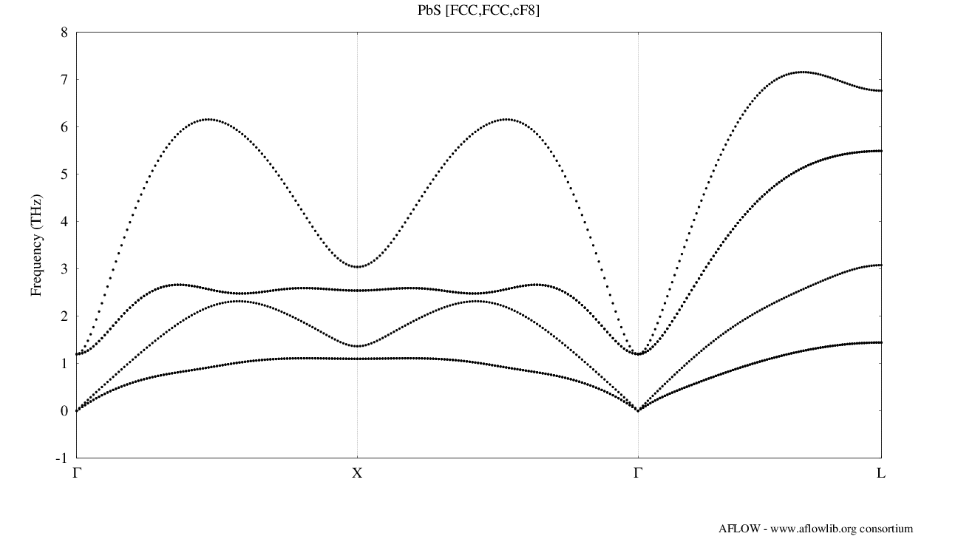
APL: Phonon calculations
AFLOW Phonon Library
Interatomic force constants
\Phi_{ij}^{\alpha \beta } &= \frac{\partial^2V}{\partial r_{i}^{\alpha} \partial r_{j}^{\beta} }
\Phi_{ijk}^{\alpha \beta \gamma} &= \frac{\partial^3V}{\partial r_{i}^{\alpha} \partial r_{j}^{\beta} \partial r_{k}^{\gamma}}
\omega_{\lambda}, e_{\lambda}
Phonon dispersion
D_{ij}^{\alpha \beta }(\mathbf{q}) = \sum_l \frac{\Phi(i,j)_{\alpha \beta}}{\sqrt{M(i)M(j)}}\exp\left[-i\mathbf{q} \cdot \left(\mathbf{R}_{l}-\mathbf{R}_{0}\right)\right]
Perturb atom, obtain change in force on others
Curtarolo et al., Comput. Mater. Sci. 58, 218 (2012); Curtarolo et al., Comput. Mater. Sci. 58, 227 (2012)

Slide 35
AFLOW.org: Thermo-mechanical properties
AEL-AGL combined workflow has been run for > 5000 materials
Data is accessible online at aflow.org, via AFLOW REST-API and AFLUX search-API
Elastic property keywords: ael_bulk_modulus_vrh, ael_shear_modulus_vrh, ael_poisson_ratio, …
Thermal properties keywords: agl_debye, agl_gruneisen, agl_heat_capacity_Cv_300K, agl_thermal_conductivity_300K, agl_thermal_expansion_300K, …
C. Toher et al., Phys. Rev. Mater. 1, 015401 (2017)

Slide 36
Outline
Getting started with AFLOW:
Decorating crystal prototypes to set up new calculations
Symmetry analysis
Thermodynamic and thermo-mechanical
Convex hull phase diagrams
AEL/AGL/APL: Elastic constants and thermal properties
AFLOW online data repositories
AFLOW.org online web interface
AFLOW REST-API
AFLUX Search-API
AFLOW-ML + API
AFLOW code:
Installing AFLOW
Data analysis with AFLOW
Running AFLOW calculations

Slide 37
AFLOW.org: web portal
http://aflow.org
> 1.8 million entries
Advanced Search
Crystal Prototypes
Machine-learning model
Convex hull
AFLOW-online
(AFLOW-SYM)
Curtarolo et al., Comput. Mater. Sci. 58, 218 (2012); Curtarolo et al., Comput. Mater. Sci. 58, 227 (2012)

Slide 38
AFLOW.org: search page
Element group selection
Element selection
Property Filters
Number of species
http://aflow.org/advanced.php
R. H. Taylor et al., Comput. Mater. Sci. 93, 178-192 (2014)

Slide 39
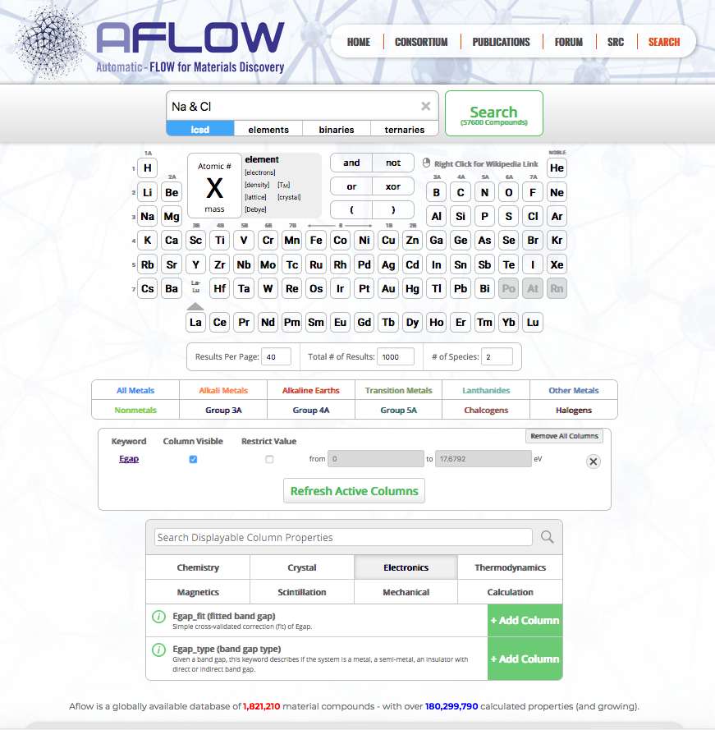
AFLOW.org: search page
Selected Elements
Number of species=2
Check box to restrict search results to specific value range
Added filter for Egap: electronic band bap
http://aflow.org/advanced.php
R. H. Taylor et al., Comput. Mater. Sci. 93, 178-192 (2014)

Slide 40
AFLOW.org: search page
Exercises:
Use the advanced search functionality to find the band gap for SiC in the zincblende structure (space group number 216).
Use the advanced search functionality to find the bulk moduli for materials containing Ti in the AFLOW database. How many results are returned?
Use the “Restrict Value” button to limit the search to only entries for which the bulk modulus has already been calculated for materials containing Ti. Open the entry page of the material with the highest bulk modulus. What is the lattice type and space group of this material? Is it a metal or an insulator?
G (p, T; V) = E + pV
R. H. Taylor et al., Comput. Mater. Sci. 93, 178-192 (2014)

Slide 41
AFLOW.org: database organization
R. H. Taylor et al., Comput. Mater. Sci. 93, 178-192 (2014)

Slide 42
AFLOW: REST-API
R. H. Taylor et al., Comput. Mater. Sci. 93, 178-192 (2014)

Slide 43
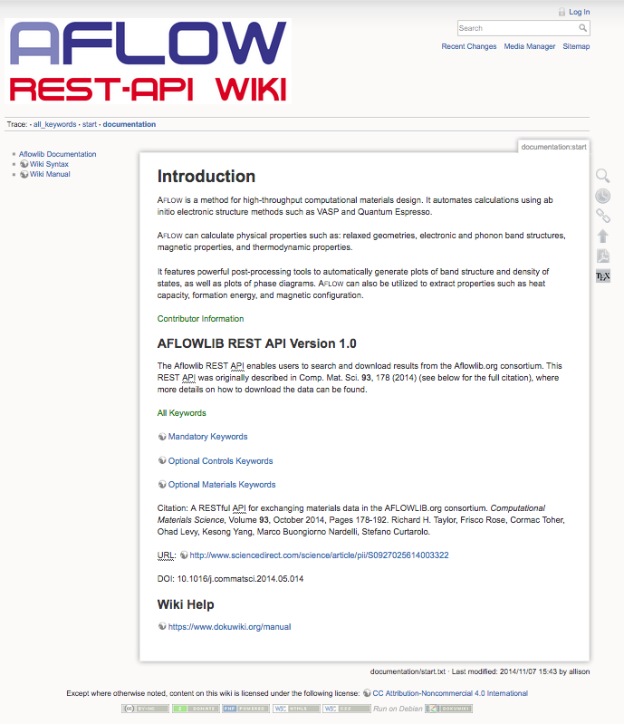
AFLOW.org: web portal
Full list of API keywords is available in the online REST-API documentation wiki:
Keywords lists
R. H. Taylor et al., Comput. Mater. Sci. 93, 178-192 (2014)

Slide 44
AFLOW: REST-API
The AFLOW REST-API AFLOW URL (AURL) has the form:
<server>:AFLOWDATA/<project>/<set>/<entry>/?<keyword>
For example, the AURL for the formation enthalpy per atom of the ternary Heusler structure T0001.A2BC with composition Cu₂TiZn is:
aflowlib.duke.edu:AFLOWDATA/LIB3_RAW/Cu_pvTi_svZn/T0001.A2BC/?enthalpy_formation_atom
Server
Project Layer
Set Layer
Entry
Keyword
The URL for the formation enthalpy per atom of the ternary Heusler structure T0001.A2BC with composition Cu₂TiZn is:
aflowlib.duke.edu/AFLOWDATA/LIB3_RAW/Cu_pvTi_svZn/T0001.A2BC/?enthalpy_formation_atom
The full list of entries in the set Cu-Ti-Zn can be retrieved using:
aflowlib.duke.edu/AFLOWDATA/LIB3_RAW/Cu_pvTi_svZn/?aflowlib_entries
R. H. Taylor et al., Comput. Mater. Sci. 93, 178-192 (2014)

Slide 45
AFLOW: REST-API
Example python script to access API & download space groups (see AFLOW_REST_API_example.py):
#!/usr/bin/env python
import json, sys, os
from urllib import urlopen
SERVER="http://aflowlib.duke.edu/AFLOWDATA"
PROJECT="/LIB3_RAW"
SET="/Cu_pvTi_svZn"
ENTRIES="/?aflowlib_entries"
response=urlopen( SERVER+PROJECT+SET+ENTRIES ).read()
response=response.rstrip()
entry_list=response.split(",")
print(entry_list)
for i in xrange(len(entry_list)):
entry=str(entry_list[i])
URLentry_sg=SERVER+PROJECT+SET+"/"+entry+"/?spacegroup_relax"
print(URLentry_sg)
response=urlopen( URLentry_sg ).read()
print(response)
Project: Ternary alloys
Set: CuTiZn alloy system
Keyword: List of entries in this alloy system
Download list of entries with urlopen
Loop through list of entries
Download space group for each entry
R. H. Taylor et al., Comput. Mater. Sci. 93, 178-192 (2014)

Slide 46
AFLOW: REST-API
Exercises:
Use the AFLOW REST-API to download the formation enthalpies for all of the entries in the ternary alloy system AlNiTi (AlNi_pvTi_sv).
Use the AFLOW REST-API to download the full list of binary alloy systems that are available in the LIB2 project. How many alloys systems are available for download?
Use the AFLOW REST-API to download the stoichiometries and space groups for all of the entries in an alloy system of your choice. How many entries are present in this system?
G (p, T; V) = E + pV
R. H. Taylor et al., Comput. Mater. Sci. 93, 178-192 (2014)

Slide 47
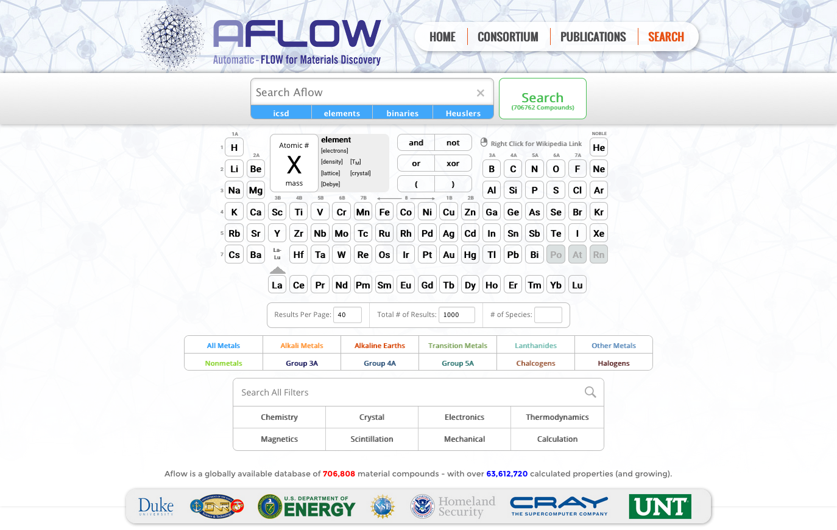
AFLUX: AFLOW Search-API
Logical operator | LUX syntax
<block> | “(” and “)”
<AND> | “,”
<OR> | “:”
<NOT> | “!”
<loose> | “*”
<string> | “’”
<mute> | “$”
Aim: Programatically expose the same functionality as our web search interface at http://aflow.org/advanced.php
F. Rose et al., Comput. Mater. Sci. 137, 362 (2017).

Slide 48
AFLUX: AFLOW Search-API
AFLUX enables search functionality through query part of URI
Supports use of several logical operators
Operator scope can be inter-property and/or intra-property
Logical operator | AFLUX syntax | Operator scope
<block> | “(” and “)” | Intra- and inter-property
<AND> | “,” | Intra- and inter-property
<OR> | “:” | Intra- and inter-property
<NOT> | “!” | Intra-property
<loose> | “*” | Intra-property
<string> | “’” | Inter-property
<mute> | “$” | Intra-property
F. Rose et al., Comput. Mater. Sci. 137, 362 (2017).

Slide 49
AFLUX: AFLOW Search-API
http://aflowlib.duke.edu/search/API/?<matchbook>,<directives>
Search API Server
Query
Matchbook:
Materials keywords with arguments
Example: <server>/?species((Na:K),Cl),nspecies(2),Egap(1*,*5),energy_cell
Keyword list available from schema directive: <server>/?schema
Directives:
Formatting instructions with arguments
“format” takes arguments “json” and “html”
“catalog” takes arguments “icsd”, “lib1”, “lib2”, ...
“paging” controls number of entries and page displayed, sorted in ascending order of first materials keyword – order can be reversed by using a negative page number in the argument
F. Rose et al., Comput. Mater. Sci. 137, 362 (2017).

Slide 50
AFLUX: AFLOW Search-API
Example python script to access AFLUX search-API (see AFLUX_example.py):
#!/usr/bin/env python
import json, sys, os
from urllib import urlopen
SERVER="http://aflowlib.duke.edu"
API="/search/API/?"
MATCHBOOK="species((Na:K),Cl),nspecies(2),Egap(2*,*5),energy_cell"
DIRECTIVES="$paging(0)"
SUMMONS=MATCHBOOK+","+DIRECTIVES
response=json.loads(urlopen(SERVER+API+SUMMONS).read().decode("utf-8"))
for datum in response:
bandgap=[float(x) for x in datum['Egap'].split(",")]
energycell=[float(x) for x in datum['energy_cell'].split(",")]
print ("{}, {}, {}".format( datum['auid'], bandgap, energycell))
AFLUX Server
Matchbook: materials keywords
Directive: return all entries satisfying query
JSON with query results is downloaded
F. Rose et al., Comput. Mater. Sci. 137, 362 (2017).

Slide 51
AFLUX: AFLOW Search-API
Exercises:
Use AFLUX to retrieve the formation enthalpies for all of the entries in a ternary alloy system of your choice.
Use AFLUX to retrieve the space group numbers of all materials that contain Cu and Ti but not V (the logical NOT operator is denoted by the exclamation mark “!”).
Use AFLUX to retrieve the band gaps of all of the materials that have a calculated bulk modulus between 200GPa and 300GPa.
Use AFLUX to retrieve the materials in the ICSD catalog that contain the element Sn but not Pb, and that have a band gap between 1 and 3eV. How many such materials are available?
G (p, T; V) = E + pV
F. Rose et al., Comput. Mater. Sci. 137, 362 (2017).

Slide 52
Outline
Getting started with AFLOW:
Decorating crystal prototypes to set up new calculations
Symmetry analysis
Thermodynamic and thermo-mechanical
Convex hull phase diagrams
AEL/AGL/APL: Elastic constants and thermal properties
AFLOW online data repositories
AFLOW.org online web interface
AFLOW REST-API
AFLUX Search-API
AFLOW-ML + API
AFLOW code:
Installing AFLOW
Data analysis with AFLOW
Running AFLOW calculations

Slide 53
AFLOW Machine Learning
AFLOW data for > 26,674 materials on AFLOW.org used to train gradient boosting decision trees machine-learning model
Predictions based on structural morphology and elemental properties
Voronoi tessellation used to determine atomic connectivity
Atoms which share a Voronoi cell face are connected to form a graph
O. Isayev et al., Nat. Commun. 8, 15679 (2017).

Slide 54
AFLOW Machine Learning
Connected atoms form structure fragments descriptors
Atomic nodes in structure fragments are decorated with elemental properties to form Property-Labeled Materials Fragments (PLMF)
Properties used include number of valence electrons, ionization potential, electron affinity, electronegativity, covalent radii, etc.
O. Isayev et al., Nat. Commun. 8, 15679 (2017).

Slide 55
AFLOW Machine Learning
Model predicts electronic and thermo-mechanical properties
Model predicts electronic band gap for non-metals
O. Isayev et al., Nat. Commun. 8, 15679 (2017).

Slide 56
AFLOW Machine Learning
ML model trained on 26674 unique GGA+U band structures from AFLOW.org to predict metal vs. insulator and electronic band gap
Statistics for 5-fold cross-validation for electronic band gap:
RMSE: 0.51eV
MAE: 0.35eV
r²: 0.90
ML prediction vs. DFT+U calculation
O. Isayev et al., Nat. Commun. 8, 15679 (2017).

Slide 57
AFLOW Machine Learning
Partial dependence on elemental properties can be used to formulate design rules for new materials
Partial dependence:
metal vs. insulator
Partial dependence:
Band gap vs. ionization potential
O. Isayev et al., Nat. Commun. 8, 15679 (2017).

Slide 58
AFLOW Machine Learning
Partial dependence of properties on descriptors:
Good agreement of predictions with both DFT and experiment
O. Isayev et al., Nat. Commun. 8, 15679 (2017).

Slide 59
AFLOW.org: web portal
http://aflow.org
Machine-learning model
Curtarolo et al., Comput. Mater. Sci. 58, 218 (2012); Curtarolo et al., Comput. Mater. Sci. 58, 227 (2012)

Slide 60
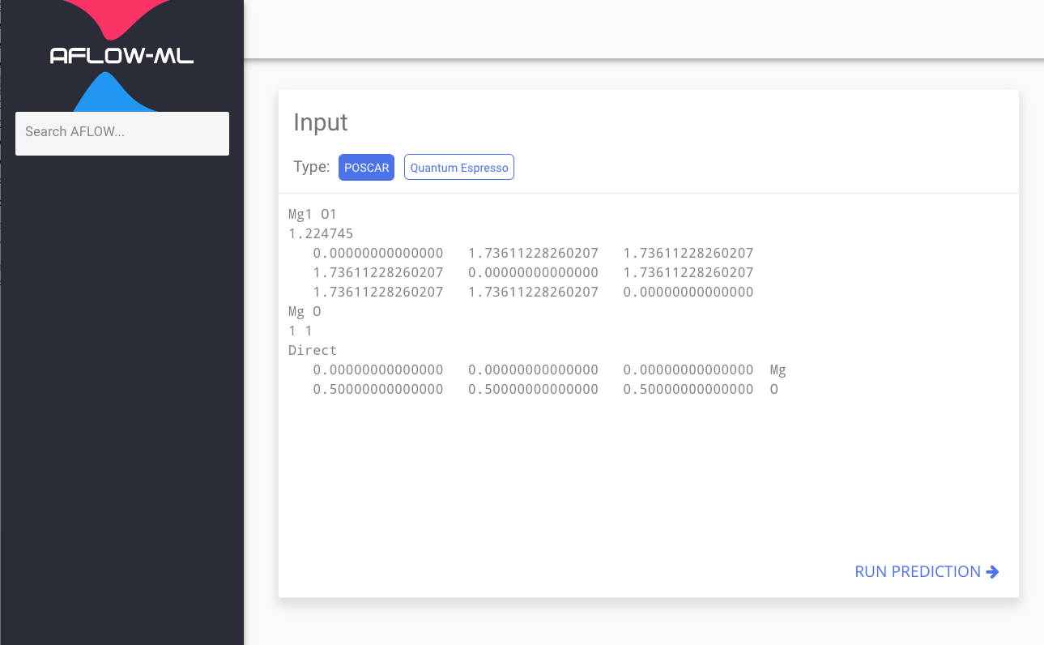
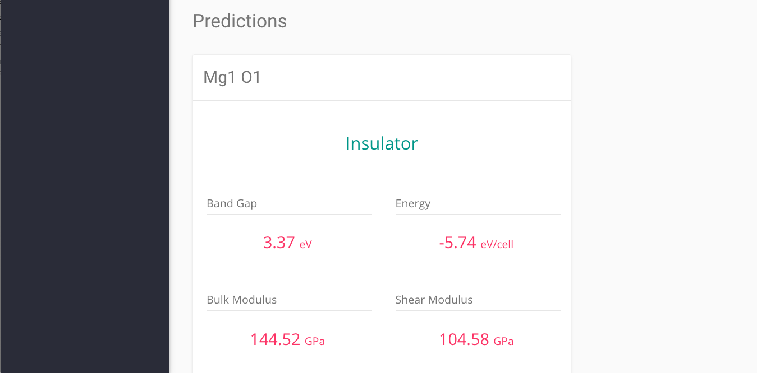
AFLOW-ML Online
Models are available online at aflow.org/aflow-ml
O. Isayev et al., Nat. Commun. 8, 15679 (2017), E. Gossett et al., Comput. Mater. Sci. 152, 134-145 (2018).

Slide 61
AFLOW-ML API
Models are now programmatically accessible via AFLOW-ML API
E. Gossett et al., Comput. Mater. Sci. 152, 134-145 (2018).

Slide 62
AFLOW-ML API
Post POSCAR (for VASP version 5) to API using e.g. cURL:
Mg1O1 [FCC,FCC,cF8] (STD_PRIM doi:10.1016/j.commatsci.2010.05.010)
1.224745
0.00000000000000 1.73622980869126 1.73622980869126
1.73622980869126 0.00000000000000 1.73622980869126
1.73622980869126 1.73622980869126 0.00000000000000
Mg O
1 1
Direct(2) [A1B1]
0.00000000000000 0.00000000000000 0.00000000000000 Mg
0.50000000000000 0.50000000000000 0.50000000000000 O
> curl http://aflow.org/API/aflow-ml/v1.0/plmf/prediction
--data-urlencode file@POSCAR
Receive JSON file with task ID:
{
"id": "531c2817-ee51-4a23-be61-6e8ca6f31aec",
"model": "plmf",
"results_endpoint": "/prediction/result/531c2817-ee51-4a23-be61-6e8ca6f31aec"
}
E. Gossett et al., Comput. Mater. Sci. 152, 134-145 (2018).

Slide 63
AFLOW-ML API
Use task ID to query endpoint to retrieve results:
> curl http://aflow.org/API/aflow-ml/v1.0/prediction/result/531c2817-ee51-4a23-be61-6e8ca6f31aec
Receive JSON file with results:
{
"citation": "10.1038/ncomms15679",
"description": "The job has completed.",
"ml_ael_bulk_modulus_vrh": 144.522,
"ml_ael_shear_modulus_vrh": 104.453,
"ml_agl_debye": 777.163,
"ml_agl_heat_capacity_Cp_300K": 4.33,
"ml_agl_heat_capacity_Cp_300K_per_atom": 2.194,
"ml_agl_heat_capacity_Cv_300K": 4.178,
"ml_agl_heat_capacity_Cv_300K_per_atom": 2.139,
"ml_agl_thermal_conductivity_300K": 3.509,
"ml_agl_thermal_expansion_300K": 6.18e-05,
"ml_egap": 3.375,
"ml_egap_type": "Insulator",
"ml_energy_per_atom": -5.742,
"model": "plmf",
"status": "SUCCESS"
}
E. Gossett et al., Comput. Mater. Sci. 152, 134-145 (2018).

Slide 64
AFLOW-ML API
Example python script to access AFLOW-ML API (part 1 of AFLOW-ML_example.py):
#!/usr/bin/env python
import json, sys, os
from urllib import urlopen
from urllib import urlencode
import urllib2
from time import sleep
SERVER="http://aflow.org"
API="/API/aflow-ml/v1.0"
MODEL="plmf"
poscar=open('POSCAR', 'r').read()
encoded_data = urlencode({'file': poscar,})
url = SERVER + API + "/" + MODEL + "/prediction"
request_task = urllib2.Request(url, encoded_data)
task = urllib2.urlopen(request_task).read()
task_json = json.loads(task)
results_endpoint = task_json["results_endpoint"]
results_url = SERVER + API + results_endpoint
AFLOW-ML API server
PLMF model
Read and encode POSCAR structure file
Post POSCAR to ML API server
Extract results endpoint from returned task object
E. Gossett et al., Comput. Mater. Sci. 152, 134-145 (2018).

Slide 65
AFLOW-ML API
Example python script to access AFLOW-ML API (part 2 of AFLOW-ML_example.py):
Query results endpoint until results are retrieved
incomplete = True
while incomplete:
request_results = urllib2.Request(results_url)
results = urllib2.urlopen(request_results).read()
results_json = json.loads(results)
if results_json["status"] == 'PENDING':
sleep(10)
continue
elif results_json["status"] == ’STARTED':
sleep(10)
continue
elif results_json["status"] == 'FAILURE':
print("Error: prediction failure")
incomplete = False
elif results_json["status"] == 'SUCCESS':
print("Successful prediction")
print(results_json)
incomplete = False
If prediction is incomplete, wait and requery endpoint
Print error message for prediction failure
Print results for successful prediction
E. Gossett et al., Comput. Mater. Sci. 152, 134-145 (2018).

Slide 66
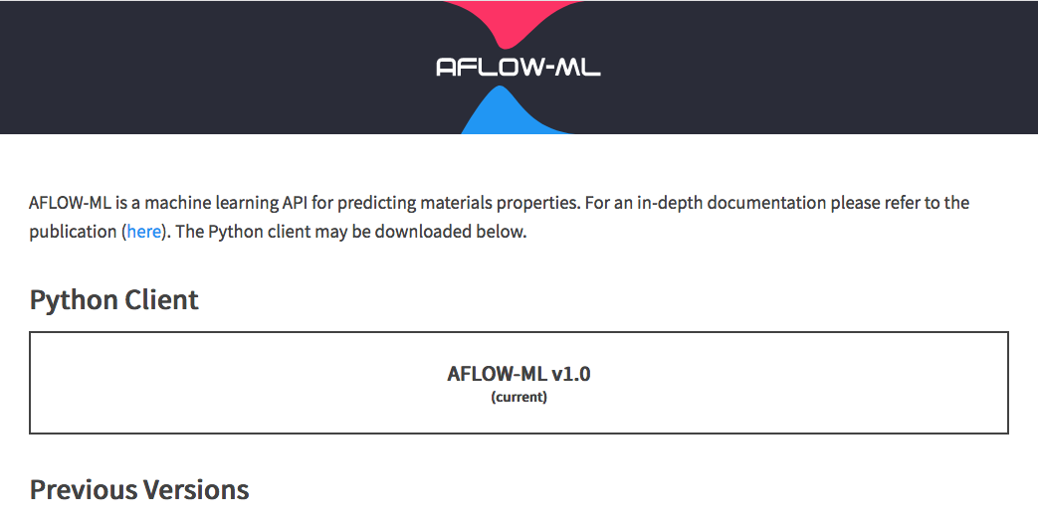
AFLOW-ML API
AFLOW-ML API Python client can be downloaded from:
http://aflow.org/src/aflow-ml/
E. Gossett et al., Comput. Mater. Sci. 152, 134-145 (2018).

Slide 67
AFLOW-ML API
AFLOW-ML API Python client can be installed using “setup.py” script included in client
python setup.py install
AFLOW-ML API Python client can be run using a script of this form:
from AFLOWml.client import AFLOWmlAPI
from pprint import pprint
with open('test.poscar', 'r') as input_file:
ml = AFLOWmlAPI()
data = ml.get_prediction(input_file.read(), 'plmf')
pprint(data)
E. Gossett et al., Comput. Mater. Sci. 152, 134-145 (2018).

Slide 68
AFLOW-ML API
Exercises:
Convert the POSCAR files, generated previously using the AFLOW prototype modules, to the format used by version 5 of VASP by adding the additional line with the element symbols. Upload the POSCARs to the aflow.org/aflow-ml page, and generate predictions. Are these materials predicted to be metals or insulators?
Use the AFLOW-ML API to obtain predictions for both the plmf and mfd models for these structures, and retrieve the results in JSON format. For the structures generated using the prototype A_hR1_166_a, how does the value of c/a affect the elastic moduli and electronic band gap? What properties can you obtain using the mfd model?
G (p, T; V) = E + pV
E. Gossett et al., Comput. Mater. Sci. 152, 134-145 (2018).

Slide 69
Outline
Getting started with AFLOW:
Decorating crystal prototypes to set up new calculations
Symmetry analysis
Thermodynamic and thermo-mechanical
Convex hull phase diagrams
AEL/AGL/APL: Elastic constants and thermal properties
AFLOW online data repositories
AFLOW.org online web interface
AFLOW REST-API
AFLUX Search-API
AFLOW-ML + API
AFLOW code:
Installing AFLOW
Data analysis with AFLOW
Running AFLOW calculations

Slide 70
AFLOW: Installation
AFLOW can be installed using the xaflow script.
Install xaflow (perform once)
G (p, T; V) = E + pV
1. Download xaflow
1. Download xaflow:
wget materials.duke.edu/AFLOW/xaflow
2. Move/copy xaflow somewhere in your path:
mv xaflow /usr/local/bin/xaflow
3. Ensure the file can be executed:
chmod 555 /usr/local/bin/xaflow
4. Check that xaflow is in your path:
which xaflow
- A returned path means xaflow has been successfully installed.
5. Run xaflow:
xaflow
- xaflow downloads, unpacks, and makes AFLOW in
$(HOME)/src/AFLOW_local_YYMMDD_hhmm (Year, Month, Date, hour, minute).
- The compilation can be redirected to another path:
xaflow AWD=~/src/AFLOW_STANDARD
6. Install the newly compiled executable to your path:
xaflow install AWD=~/src/AFLOW_STANDARD
- By default, the executable is installed to /usr/local/bin.
- The installation can be redirected to another path:
xaflow install AWD=~/src/AFLOW_STANDARD ULB=~/bin
wget materials.duke.edu/AFLOW/xaflow
2. Move/copy xaflow somewhere in your path
mkdir ~/bin
export PATH=~/bin:$PATH
mv xaflow ~/bin/xaflow
3. Ensure the file can be executed
chmod 555 ~/bin/xaflow
4. Check that xaflow is in your path
which xaflow
Curtarolo et al., Comput. Mater. Sci. 58, 218 (2012); Curtarolo et al., Comput. Mater. Sci. 58, 227 (2012)

Slide 71
AFLOW: Installation
Install AFLOW (perform with every new version)
1. Run xaflow
xaflow
G (p, T; V) = E + pV
- xaflow compiles AFLOW in ~/src/AFLOW by default
- To change the compilation directory, run
1. Download xaflow:
wget materials.duke.edu/AFLOW/xaflow
2. Move/copy xaflow somewhere in your path:
mv xaflow /usr/local/bin/xaflow
3. Ensure the file can be executed:
chmod 555 /usr/local/bin/xaflow
4. Check that xaflow is in your path:
which xaflow
- A returned path means xaflow has been successfully installed.
5. Run xaflow:
xaflow
- xaflow downloads, unpacks, and makes AFLOW in
$(HOME)/src/AFLOW_local_YYMMDD_hhmm (Year, Month, Date, hour, minute).
- The compilation can be redirected to another path:
xaflow AWD=~/src/AFLOW_STANDARD
6. Install the newly compiled executable to your path:
xaflow install AWD=~/src/AFLOW_STANDARD
- By default, the executable is installed to /usr/local/bin.
- The installation can be redirected to another path:
xaflow install AWD=~/src/AFLOW_STANDARD ULB=~/bin
xaflow AWD=/home/src/AFLOW
2. Install the newly compiled executable to your path
xaflow install
- xaflow installs AFLOW to ~/bin by default
- To change the compilation directory, run
xaflow install ULB=/usr/local/bin
3. Run aflow
aflow
Curtarolo et al., Comput. Mater. Sci. 58, 218 (2012); Curtarolo et al., Comput. Mater. Sci. 58, 227 (2012)

Slide 72
AFLOW: Configuration
AFLOW can be configured with the .aflow.rc file
Machine settings
MPI options
Binary paths
Database paths
G (p, T; V) = E + pV
1. Download xaflow:
wget materials.duke.edu/AFLOW/xaflow
2. Move/copy xaflow somewhere in your path:
mv xaflow /usr/local/bin/xaflow
3. Ensure the file can be executed:
chmod 555 /usr/local/bin/xaflow
4. Check that xaflow is in your path:
which xaflow
- A returned path means xaflow has been successfully installed.
5. Run xaflow:
xaflow
- xaflow downloads, unpacks, and makes AFLOW in
$(HOME)/src/AFLOW_local_YYMMDD_hhmm (Year, Month, Date, hour, minute).
- The compilation can be redirected to another path:
xaflow AWD=~/src/AFLOW_STANDARD
6. Install the newly compiled executable to your path:
xaflow install AWD=~/src/AFLOW_STANDARD
- By default, the executable is installed to /usr/local/bin.
- The installation can be redirected to another path:
xaflow install AWD=~/src/AFLOW_STANDARD ULB=~/bin
VASP specific settings
POTCAR paths (pseudo potentials files)
Precision defaults (k-points scheme, minimization algorithm, energy cutoff, etc.)
Run setting defaults (spin-polarized calculation, symmetry determination, etc.)
AFLOW settings
Output file names
Graphic settings (Gnuplot, LaTeX)
aflow --readme=aflowrc
Curtarolo et al., Comput. Mater. Sci. 58, 218 (2012); Curtarolo et al., Comput. Mater. Sci. 58, 227 (2012)

Slide 73
AFLOW: Crystallographic Prototypes
Decorate rock-salt prototype AB_cF8_225_a_b with MgO:
aflow --proto=AB_cF8_225_a_b:Mg:O --params=3.5
AB_cF8_225_a_b params=3.5 SG#=225 [ANRL doi: arXiv:1607.02532]
1.000000
0.00000000000000 1.75000000000000 1.75000000000000
1.75000000000000 0.00000000000000 1.75000000000000
1.75000000000000 1.75000000000000 0.00000000000000
1 1
Direct(2) [A1B1]
0.00000000000000 0.00000000000000 0.00000000000000 Mg
0.50000000000000 0.50000000000000 0.50000000000000 O
G (p, T; V) = E + pV
Use Heusler prototype T0001.A2BC to create aflow.in file for Cu₂TiZn:
aflow --aflow_proto=T0001.A2BC:Cu:Ti:Zn
Variety of possible ab-initio formats by adding options:
VASP
FHI-AIMS
Quantum Espresso
ABINIT
--vasp
--aims
--qe
--abinit
M. J. Mehl et al., Comput. Mater. Sci. 136, S1-S828 (2017); D. Hicks et al., submitted (2018)

Slide 74
AFLOW: High throughput aflow.in’s
Comma separated prototypes
aflow --aflow_proto=T0001.A2BC,TFCC001.ABC:Ag,Au,Cu,Fe:Mn,Ti:Zn
G (p, T; V) = E + pV
Comma separated species
aflow --aflow_proto=T0001.A2BC:Ag,Au,Cu,Fe:Mn,Ti:Zn
Pre-defined sets
aflow --aflow_proto=T0001.A2BC:LIB3:LIB3:LIB3
Full prototype listings
AFLOW Standard
AFLOW Crystallographic Library
aflow --protos
http://aflow.org/CrystalDatabase
Have fun!
Curtarolo et al., Comput. Mater. Sci. 58, 218 (2012); Curtarolo et al., Comput. Mater. Sci. 58, 227 (2012)

Slide 75
AFLOW: Crystallographic Prototypes
Exercises:
Use the aflow --proto command with the appropriate options as described on the online prototype page to generate a POSCAR for the same structure used in the previous exercise, decorated with elements of your choice.
Generate structures for the prototype A_hR1_166_a using an element and value of a of your choice, with c/a values of 0.5, 0.612, 1.0, 1.225, 1.5, 2.45, and 3.0. Save these structures with appropriate names, as they will be used as part of a later exercise.
G (p, T; V) = E + pV
M. J. Mehl et al., Comput. Mater. Sci. 136, S1-S828 (2017); D. Hicks et al., submitted (2018)

Slide 76
AFLOW-SYM
Point, factor, site-symmetry, and space group operations are calculated via:
aflow --aflowSYM < POSCAR
Tolerance values and output format can be set using the options:
G (p, T; V) = E + pV
aflow --aflowSYM=0.0001 --print=json < POSCAR
Space-group symmetry information (number/symbol, Wyckoff positions, cell setting, etc.) consistent with ITC conventions:
aflow --sgdata=0.0001 --print=json < POSCAR
Extended crystallographic data (crystal, lattice, superlattice, symmetry descriptions) can be extracted using:
aflow --edata=0.0001 --print=json < POSCAR
Other standalone symmetry commands:
Space-group number/symbol
Pearson symbol
aflow --aflowSG < POSCAR
aflow --pearson < POSCAR
Wyckoff positions (POSCAR format)
Standard primitive cell
aflow --wyccar < POSCAR
aflow --sprim < POSCAR
D. Hicks et al., Acta Cryst. A74, 184-203 (2018)

Slide 77
AFLOW-CHULL: Convex Hull Phase Diagram
Output format can be specified as usual
aflow --chull --alloy=MnPd --print=json,txt,pdf
Directly query a structure’s distance from the hull
G (p, T; V) = E + pV
aflow --chull --alloy=MnPd --d2h=aflow:9001c322296fc162
Directly query a structure’s stability criterion
aflow --chull --alloy=MnPd --sc=aflow:4fc97e549ca17d4e
Directly query the energy of the hull at a particular stoichiometry
aflow --chull --alloy=MnPd --hull_energy=0.25
High throughput inputs
aflow --chull --alloy=MnPt,PdPt
README for more options/help
aflow --chull --alloy=Mn,Pd:Pt
aflow --readme=chull
aflow --chull --alloy=LIB2:LIB2
C. Oses et al., submitted arXiv:1806.06901 (2018)

Slide 78
AFLOW: aflow.in file
The aflow.in file:
[AFLOW] **************************************************************************************************************
[AFLOW]SYSTEM=Cu_pvTi_svZn.T0001.A2BC
[AFLOW] **************************************************************************************************************
[AFLOW] input file for aflow
[AFLOW_MODE=VASP]
[AFLOW] **************************************************************************************************************
[AFLOW_MODE_ZIP=xz]
[AFLOW_MODE_BINARY=vasp46s]
[AFLOW] **************************************************************************************************************
[AFLOW] **************************************************************************************************************
#[AFLOW_MODE_MPI]
[AFLOW_MODE_MPI_MODE]NCPUS=MAX
[AFLOW_MODE_MPI_MODE]COMMAND ="mpirun -np"
[AFLOW_MODE_MPI_MODE]AUTOTUNE
[AFLOW_MODE_MPI_MODE]BINARY="mpivasp46s"
[AFLOW] **************************************************************************************************************
[AFLOW_SYMMETRY]CALC
#[AFLOW_SYMMETRY]SGROUP_WRITE
#[AFLOW_SYMMETRY]SGROUP_RADIUS=7.77
[AFLOW] **************************************************************************************************************
#[AFLOW_NEIGHBOURS]CALC
[AFLOW_NEIGHBOURS]RADIUS=7.7
[AFLOW_NEIGHBOURS]DRADIUS=0.1
[AFLOW] **************************************************************************************************************
#[AFLOW_APL]CALC // README_AFLOW_APL.TXT
[AFLOW_APL]ENGINE=DM // README_AFLOW_APL.TXT
[AFLOW_APL]DMAG=0.015 // README_AFLOW_APL.TXT
[AFLOW_APL]MINATOMS=100 // README_AFLOW_APL.TXT
#[AFLOW_APL]SUPERCELL=3x3x3 // README_AFLOW_APL.TXT
[AFLOW_APL]DC=y // README_AFLOW_APL.TXT
[AFLOW_APL]DPM=y // README_AFLOW_APL.TXT
[AFLOW_APL]ZEROSTATE=y // README_AFLOW_APL.TXT
[AFLOW_APL]DOS=y // README_AFLOW_APL.TXT
[AFLOW_APL]TP=y // README_AFLOW_APL.TXT
[AFLOW_APL]TPT=0:2000:10 // README_AFLOW_APL.TXT
System name
G (p, T; V) = E + pV

Slide 79
AFLOW: aflow.in file
The aflow.in file:
[AFLOW] *************************************************************************************************************
[VASP_RUN]RELAX_STATIC_BANDS=2 // GENERATE | STATIC | RELAX=N | RELAX_STATIC=N | STATIC_BANDS | RELAX_STATIC_BANDS=N | REPEAT_BANDS [,DS[,DD[,DSCF]]]
[VASP_FORCE_OPTION]NEGLECT_NOMIX
#[VASP_FORCE_OPTION]KPOINTS=keyword[,keyword] // EVEN | ODD | KSHIFT_GAMMA_EVEN | KSHIFT_GAMMA_ODD | KSCHEME_MONKHORST_PACK | KSCHEME_GAMMA | GAMMA | KEEPK | IBZKPT
[VASP_FORCE_OPTION]SYM=ON // ON | OFF (default ON)
[VASP_FORCE_OPTION]AUTO_PSEUDOPOTENTIALS=potpaw_PBE // pot_LDA | pot_GGA | potpaw_LDA | potpaw_GGA | potpaw_PBE | potpaw_LDA_KIN | potpaw_PBE_KIN
[VASP_FORCE_OPTION]NBANDS // Estimate Bands (better than VASP)
#[VASP_FORCE_OPTION]PSTRESS=0.0 // Pressure in kBar (1kB=0.1GPa)
#[VASP_FORCE_OPTION]EDIFFG=-0.001 // EDIFFG for relaxed forces
#[VASP_FORCE_OPTION]ENMAX_MULTIPLY=1.4 // Multiplication of the max(pseudopotential_cutoffs)
#[VASP_FORCE_OPTION]POTIM=0.5 // ionic time-step
[VASP_FORCE_OPTION]SPIN=ON // (ON | OFF (default ON)), REMOVE_RELAX_1 | _2
#[VASP_FORCE_OPTION]AUTO_MAGMOM=ON // ON | OFF (default OFF)
[VASP_FORCE_OPTION]RELAX_MODE=ENERGY // (ENERGY | FORCES | ENERGY_FORCES | FORCES_ENERGY) (default: DEFAULT_VASP_FORCE_OPTION_RELAX_MODE_SCHEME in .aflow.rc)
[VASP_FORCE_OPTION]PREC=ACCURATE // (LOW | MEDIUM | NORMAL | HIGH | ACCURATE), PRESERVED (default: DEFAULT_VASP_FORCE_OPTION_PREC_SCHEME in .aflow.rc)
[VASP_FORCE_OPTION]ALGO=FAST // (NORMAL | VERYFAST | FAST | ALL | DAMPED), PRESERVED (default: DEFAULT_VASP_FORCE_OPTION_ALGO_SCHEME in .aflow.rc)
#[VASP_FORCE_OPTION]METAGGA=NONE // (TPSS | RTPSS | M06L | MBJL | SCAN | MS0 | MS1 | MS2 | NONE) (default: DEFAULT_VASP_FORCE_OPTION_METAGGA_SCHEME in .aflow.rc)
#[VASP_FORCE_OPTION]IVDW=0 // (number_for_VASP_see_manual_for_IVDW | 0) (default: DEFAULT_VASP_FORCE_OPTION_IVDW_SCHEME in .aflow.rc)
[VASP_FORCE_OPTION]RELAX_ALL
#[VASP_FORCE_OPTION]NOTUNE
[VASP_FORCE_OPTION]TYPE=DEFAULT // (METAL | INSULATOR | SEMICONDUCTOR | DEFAULT) (default DEFAULT)
[VASP_FORCE_OPTION]CONVERT_UNIT_CELL=SPRIM,MINK // (SPRIM, SCONV, NIGGLI, MINK, INCELL, COMPACT, WS, CART, FRAC, PRES)
#[VASP_FORCE_OPTION]VOLUME+=10.0
[VASP_FORCE_OPTION]VOLUME*=1.05
[AFLOW] *************************************************************************************************************
G (p, T; V) = E + pV
Calculation type
Exchange-correlation functional
Relaxation mode
Basis cut-off

Slide 80
AFLOW: aflow.in file
The aflow.in file:
[AFLOW] *************************************************************************************************************
[VASP_INCAR_MODE_EXPLICIT]START
SYSTEM=Cu_pvTi_svZn.T0001.A2BC
#PSTRESS=000 # Pressure in kBar (1kB=0.1GPa) # for hand modification
#EDIFFG=-0.001 # For relaxed forces # for hand modification
#POTIM=-0.001 # default # for hand modification
#NBANDS=XX # for hand modification
#IALGO=48 # for hand modification
[VASP_INCAR_MODE_EXPLICIT]STOP
[AFLOW] *************************************************************************************************************
[VASP_KPOINTS_MODE_IMPLICIT]
[VASP_KPOINTS_FILE]KSCHEME=M
[VASP_KPOINTS_FILE]KPPRA=6000
[VASP_KPOINTS_FILE]STATIC_KSCHEME=M
[VASP_KPOINTS_FILE]STATIC_KPPRA=10000
[VASP_KPOINTS_FILE]BANDS_LATTICE=AUTO
[VASP_KPOINTS_FILE]BANDS_GRID=20
[AFLOW] *************************************************************************************************************
G (p, T; V) = E + pV
Explicit INCAR additions
k-point grid settings

Slide 81
AFLOW: aflow.in file
The aflow.in file:
[AFLOW] *************************************************************************************************************
[VASP_POSCAR_MODE_EXPLICIT]START
Cu_pvTi_svZn/T0001.A2BC - (T0001.A2BC) - AlCu2Mn [A2BC] (T0001.A2BC) & Fm(-3)m & #225 & cF16 & Navy HTQC Project (use of T0001.proto)
-56.218000
0.00000000000000 1.00000000000000 1.00000000000000
1.00000000000000 0.00000000000000 1.00000000000000
1.00000000000000 1.00000000000000 0.00000000000000
2 1 1
Direct(4) [A2B1C1]
0.75000000000000 0.75000000000000 0.75000000000000 Cu_pv
0.25000000000000 0.25000000000000 0.25000000000000 Cu_pv
0.00000000000000 0.00000000000000 0.00000000000000 Ti_sv
0.50000000000000 0.50000000000000 0.50000000000000 Zn
[VASP_POSCAR_MODE_EXPLICIT]STOP
[AFLOW] *************************************************************************************************************
[VASP_POTCAR_MODE_IMPLICIT]
[VASP_POTCAR_FILE]Cu
[VASP_POTCAR_FILE]Ti
[VASP_POTCAR_FILE]Zn
[AFLOW] potpaw_PBE: Cu_pv Ti_sv Zn
[AFLOW] COMPOSITION_PP=|Cu_pv2|Ti_sv1|Zn1|
[AFLOW] COMPOSITION=|Cu2|Ti1|Zn1|
[AFLOW] VOLUME(A^3)=|12.0159|17.1035|15.0827|
[AFLOW] MASS(amu)=|63.546|47.9|65.38|
[AFLOW] *************************************************************************************************************
G (p, T; V) = E + pV
POSCAR: VASP geometry input file
POTCAR: VASP pseudopotential

Slide 82
Running AFLOW
VASP calculations can be run through AFLOW using commands of this form:
aflow --run --force --D <run directory path>
G (p, T; V) = E + pV
The AFLOW monitor option can be used to monitor jobs to prevent them consuming excessive resources and crashing the computer:
aflow --monitor
A typical job submission script should contain something like the following:
touch log.$PBS_JOBID
aflow --monitor >> log.$PBS_JOBID &
aflow --run --force --D ./ >> log.$PBS_JOBID
AFLOW creates a “LOCK” file in directories when it starts to run VASP, preventing future AFLOW runs in that directory. To run, e.g., an APL (phonon) calculation in the same directory, change the name used for the LOCK file as follows:
aflow --use_LOCK=apl.LOCK --multi --D <run directory path>

Slide 83
AEL: Elastic constants
AFLOW-AEL is run by including the following line in the aflow.in:
[AFLOW_AEL]CALC
The number and size of the normal and shear strains can be set using the following lines:
G (p, T; V) = E + pV
[AFLOW_AEL]NNORMALSTRAINS=<number>
[AFLOW_AEL]NSHEARSTRAINS=<number>
[AFLOW_AEL]NORMALSTRAINSTEP=<number>
[AFLOW_AEL]SHEARSTRAINSTEP=<number>
Symmetry can be used to reduce the number of independent directions by including the following lines:
[AFLOW_AEL]STRAINSYMMETRY=ON
DFT calculations can be run for the strained structures in all of the subdirectories using the following command:
aflow --multi --D <directory path>
C. Toher et al., Phys. Rev. Mater. 1, 015401 (2017)

Slide 84
AEL: Elastic constants
Exercises:
Add the appropriate line to run an AEL calculation to the aflow.in file created using the Heusler prototype in the previous exercise.
Use the command aflow --run --generate_aflowin_only to create the subdirectories for this AEL calculation. (Note: this will not perform any DFT calculations, which would require VASP to be installed on your computer and can be computationally expensive. To run DFT calculations, leave out the option --generate_aflowin_only. Use the command aflow --multi --D ./ to run all subdirectories). How many subdirectories are created?
Copy the aflow.in file to a new directory, and add the option to switch on the use of symmetry to determine number of independent directions. Re-run the command to generate the subdirectories. How many subdirectories are created now?
G (p, T; V) = E + pV
C. Toher et al., Phys. Rev. Mater. 1, 015401 (2017)

Slide 85
AGL: Debye-Grüneisen model
AFLOW-AGL is run by including the following line in the aflow.in:
[AFLOW_AGL]CALC
The number and size of the isotropic strains applied to the structures can be set using the following lines:
G (p, T; V) = E + pV
[AFLOW_AGL]NSTRUCTURES=<number>
[AFLOW_AGL]STRAINSTEP=<number>
The value of the Poisson ratio used to calculate the Debye temperature can be set using the following line:
[AFLOW_AGL]POISSON=<number>
AEL can be called to calculate the Poisson ratio using the following line:
[AFLOW_AGL]AELPOISSONRATIO=ON
DFT calculations can be run for the strained structures using the following command:
aflow --multi --D <directory path>
C. Toher et al., Phys. Rev. B 90, 174107 (2014); C. Toher et al., Phys. Rev. Mater. 1, 015401 (2017)

Slide 86
AGL: Debye-Grüneisen model
Exercises:
Add the appropriate line to run an AGL calculation to the aflow.in file created using the Heusler prototype in the previous exercise.
Use the command aflow --run --generate_aflowin_only to create the subdirectories for this calculation. (Note: this will not perform any DFT calculations, which would require VASP to be installed on your computer and can be computationally expensive. To run DFT calculations, leave out the option --generate_aflowin_only. Use the command aflow --multi --D ./ to run all subdirectories). How many subdirectories are created?
Copy the aflow.in file to a new directory, and add the option to use AEL to calculate the Poisson ratio. Re-run the command to generate the subdirectories. What structures are created?
G (p, T; V) = E + pV
C. Toher et al., Phys. Rev. B 90, 174107 (2014); C. Toher et al., Phys. Rev. Mater. 1, 015401 (2017)

Slide 87
APL: Phonon calculations
AFLOW-APL is run by uncommenting the following line in the aflow.in:
[AFLOW_APL]CALC
Followed by the usual run command
G (p, T; V) = E + pV
aflow --run --LOCK=apl.LOCK
Additional parameters:
[AFLOW_APL]ENGINE=DM
[AFLOW_APL]DMAG=0.015
[AFLOW_APL]MINATOMS=100
#[AFLOW_APL]SUPERCELL=3x3x3
[AFLOW_APL]DC=y
[AFLOW_APL]DCUSERPATH=G-X|X-U|K-G|G-L
[AFLOW_APL]DPM=y
[AFLOW_APL]ZEROSTATE=y
[AFLOW_APL]POLAR=y
[AFLOW_APL]DOS=y
[AFLOW_APL]TP=y
[AFLOW_APL]TPT=0:2000:10
[AFLOW_APL]KPPRA=2000
Curtarolo et al., Comput. Mater. Sci. 58, 218 (2012); Curtarolo et al., Comput. Mater. Sci. 58, 227 (2012)

Slide 88
APL: Phonon calculations
Alternatively, a fresh aflow.in can be created with the line already uncommented
G (p, T; V) = E + pV
aflow --aflow_proto=T0001.A2BC:Cu:Ti:Zn --module=apl
DFT calculations can be run for the strained structures using the following command:
aflow --multi --D <directory path>

Slide 89
APL: Phonon calculations
Exercises:
Add/uncomment the appropriate line to run an APL calculation to the aflow.in file created using the Heusler prototype in the previous exercise.
Use the command aflow --run --generate_aflowin_only to create the subdirectories for this calculation. (Note: this will not perform any DFT calculations, which would require VASP to be installed on your computer and can be computationally expensive. To run DFT calculations, leave out the option --generate_aflowin_only. Use the command aflow --multi --D ./ to run all subdirectories). How many subdirectories are created? How many atoms do the supercells contain?
G (p, T; V) = E + pV

Slide 90
Conclusions
Automatic materials design frameworks can generate large quantities of materials data and combine multiple DFT calculations to predict thermodynamic stability and thermo-mechanical properties
AFLOW data is accessible via aflow.org web portal, AFLOW REST-API, and AFLUX Search-API
Calculated AFLOW data for electronic and thermo-mechanical properties is being used to train machine-learning models to predict these quantities, which are accessible by AFLOW-ML API
G (p, T; V) = E + pV

Slide 91


Acknowledgements
Prof. Stefano Curtarolo (Duke): Director, Center for Materials Genomics
Dr. Frisco Rose (Duke): AFLUX Search-API
Eric Gossett (Duke): convex hull online application, online ML application, AFLOW-ML API
Prof. M. Mehl, (US Naval Academy): library of crystal prototypes
Dr. O. Isayev, Prof. A. Tropsha (UNC Chapel Hill): PLMF machine learning models
Dr. F. Legrain, Dr. J. Carrete, Dr. N. Mingo (CEA Grenoble): MFD machine learning model

